Slide 1
UART 를 통한 개발 보드와 스마트폰 간의 블루투스 통신
5조 김준호 김정균 이송이 이세현

Slide 2

블루투스 통신 개요
블루투스의 무선 시스템은 ISM 주파수 대역인 2400~2483.5MHz를 사용한다.
이 주파수 대역은 산업, 의료, 과학용으로 할당된 주파수로 따로 전파사용에 대한 허가를 받을 필요가 없어서 개인 무선 통신에100m 까지 가능하다.
좁은 대역대에 많은 기기가 몰리다보니 충돌이나 간섭 가능성이 생기게 됐는데, 이를 피하기 위해 주파수 호핑기법(FHSS : Frequency Hop Spread Spectrum)을 사용하여 쓰인다.
데이터 전송 거리는 10m 정도로 최대 간섭과 페이딩을 방지한다.
주파수 호핑기법은 짧은 시간에 주파수를 이동하면서 패킷을 잘게 잘게 보내는 방식이다. 이 호핑 방식을 매칭하는게 일반적인 우리가 알고 있는 블루투스 연결이라는 개념이다.
블루투스는 Master-Slave 형태로 구성되며, 한 개의 블루투스 장치에 7개가 동시 접속 가능하다.

Slide 3
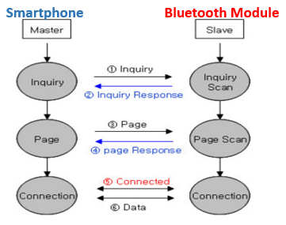
블루투스 통신 구조
블루투스는 기본적으로 Master와 Slave인 주종인 역할(ROLE)로 동작한다.
2. 통상적으로 Inquiry(검색) 및 Page(연결요청)을 하는 쪽을 Master라고 하며, Inquiry Scan(검색 대기) 및 Page Scan(연결 대기)를 하는 쪽을 Slave 라고 한다.
3. Master가 주변의 Slave를 찾으면(Inquiry), Slave는 자신의 정보를 Master에게 송신(Inquiry Response)한다.
4. Slave의 정보가 Master와 일치하면 상호 연결이 이루어 지며, 데이터 전송이 가능하게 한다.

Slide 4
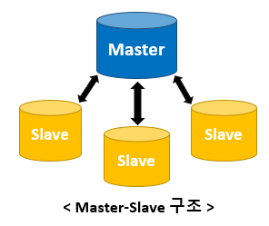
블루투스 연결을 위해서는 Master(스마트폰)이 생성하는
주파수 호핑에 Slave(모듈)를 동기화시켜야 한다.
master와 Slave는 상황에 따라 역할을 바꿀 수 있고
Slave끼리는 통신이 불가능하다.

Slide 5
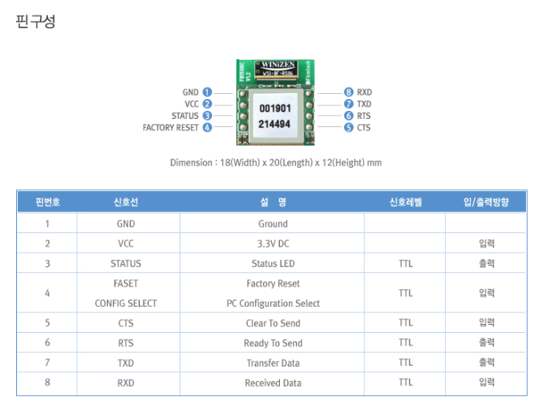
FB155BC 핀 구성

Slide 6
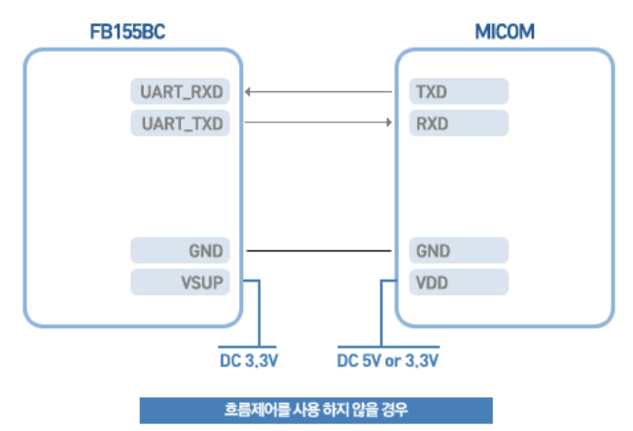
FB155BC 시스템 연결도

Slide 7
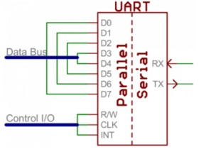
UART 통신
UART(Universal Asynchronous Receiver/Transmitter) 범용 비동기화 송수신기
병렬 데이터를 직렬 형식으로 전환하여 데이터를 전송하는 컴퓨터 하드웨어의 일종이다.
시리얼 기반 통식 방식으로 보통 RS_232 를 통해 통신을 지원한다.

Slide 8
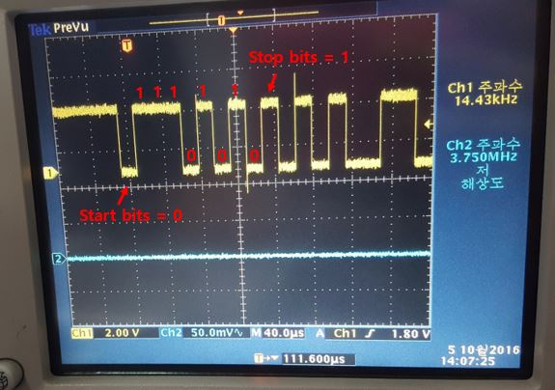
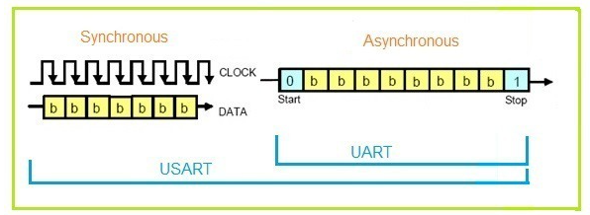
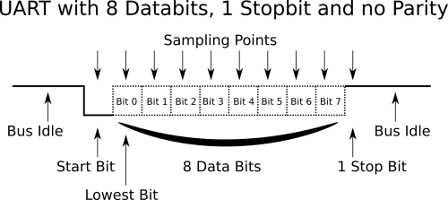
UART 통신
9600bps, 8bit, None parity
01010111(2) ’W’
동기
CLK 핀 필요, 클럭을 기준으로 전송
비동기
시작 비트는 항상 0(Always Low) 종료 비트는 항상 1(Always High)
시작과 종료가 반복될 때마다, 그 지점에선 항상 0과 1

Slide 9
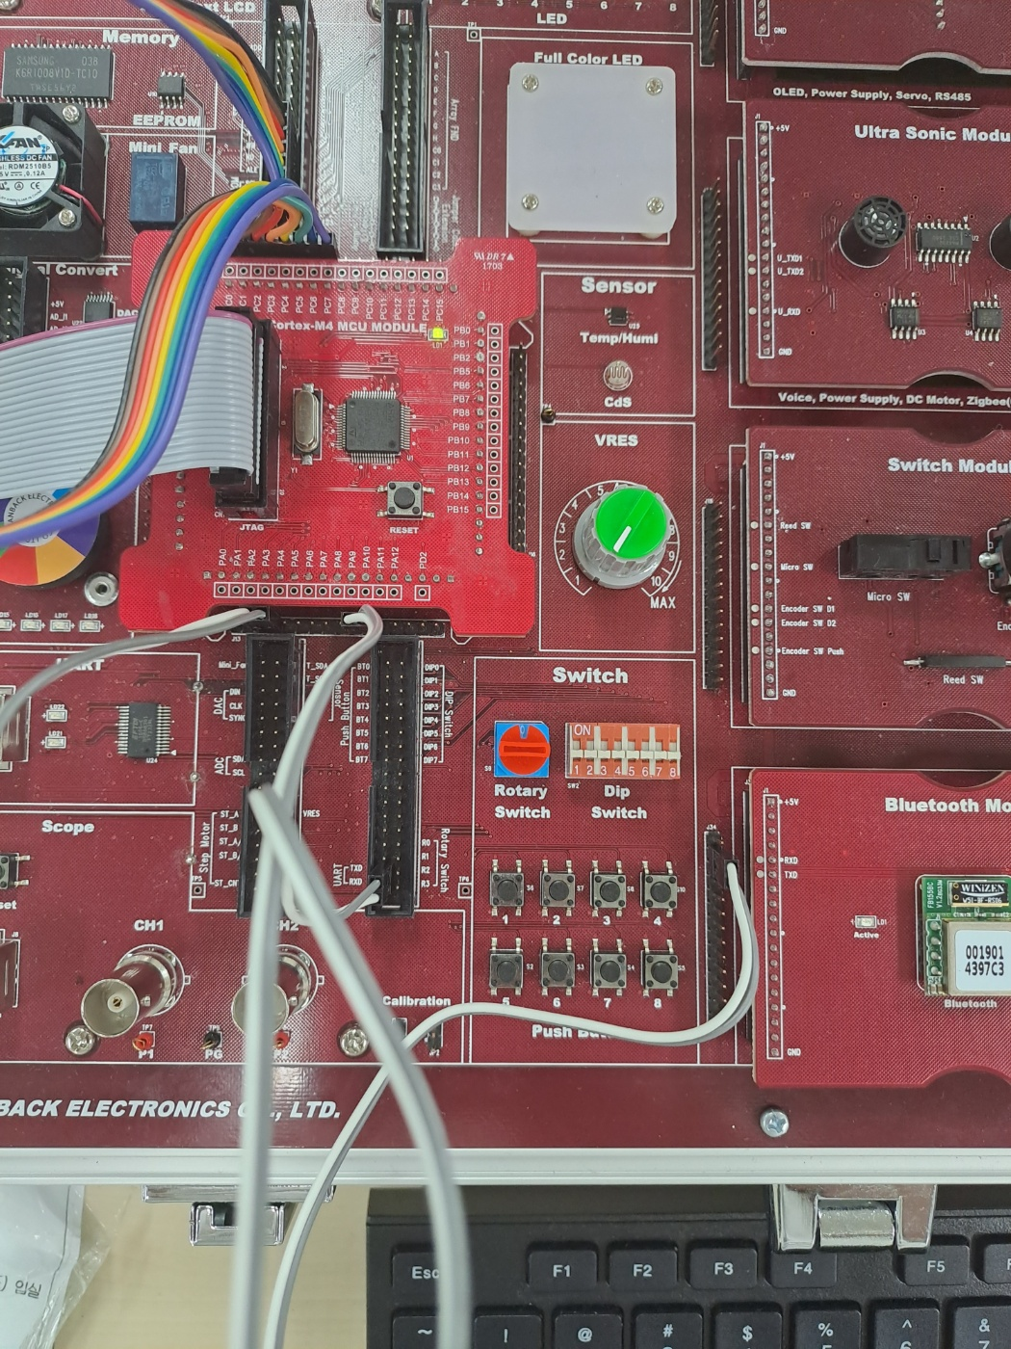
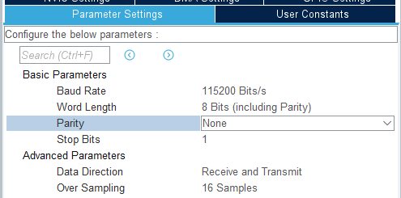
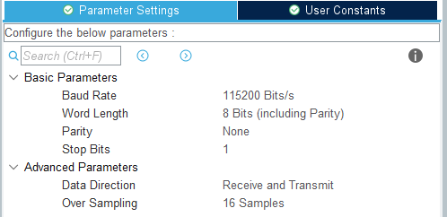
회로 구성
USART2
USART1
USART2
USART1
PC
MCU
FB155BC
RX
TX
TX
PA3
RX
PA2
TX
PA9
RX
PA10
RX
TX
PC - MCU
MCU – 모듈
(스마트폰)

Slide 10
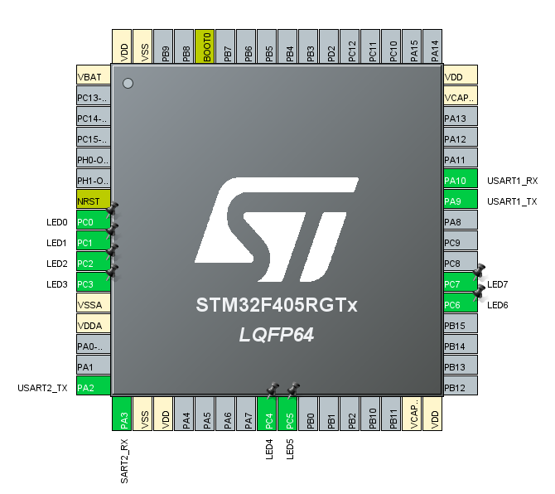
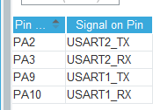
핀 설정
PC0 ~ PC7 GPIO_OUTUT

Slide 11
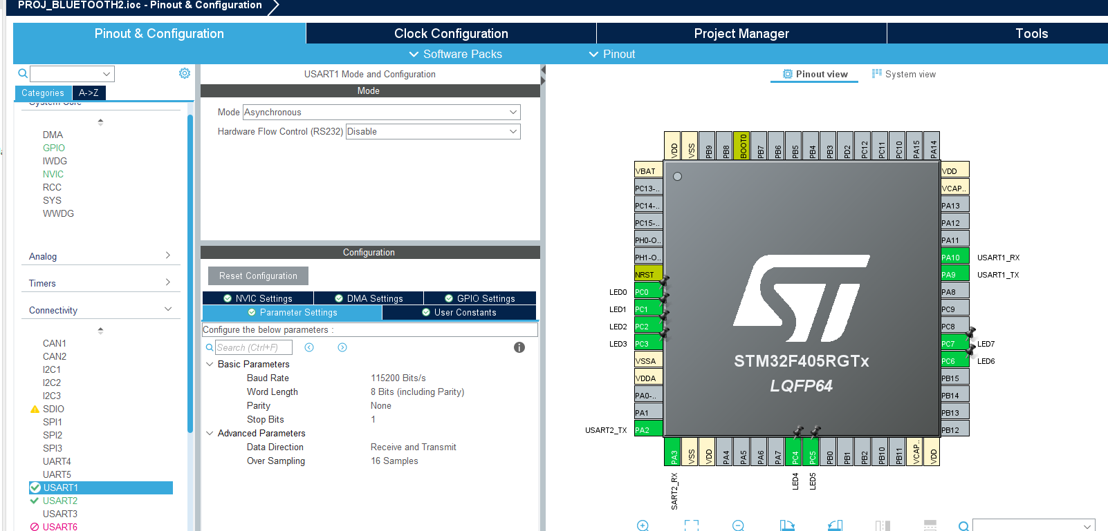
USART1 설정 (MCU -FB155BC)

Slide 12
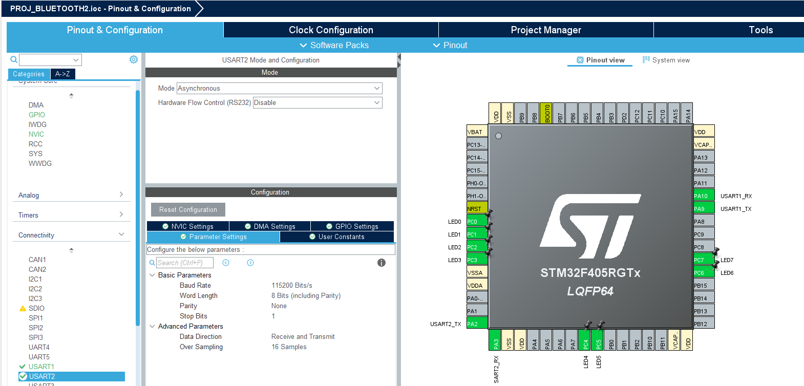
USART2 설정 (PC - MCU)

Slide 13
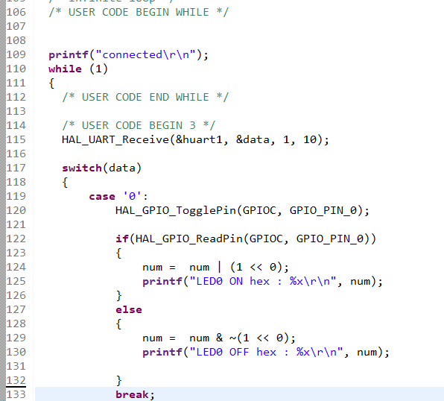
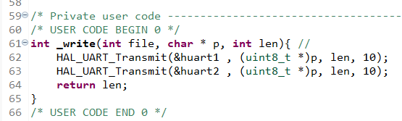
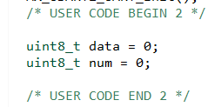
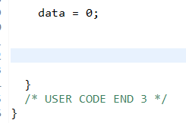
main.c
. . .
Notes:
/* USER CODE BEGIN Header */
/**
******************************************************************************
* @file : main.c
* @brief : Main program body
******************************************************************************
* @attention
*
* Copyright (c) 2023 STMicroelectronics.
* All rights reserved.
*
* This software is licensed under terms that can be found in the LICENSE file
* in the root directory of this software component.
* If no LICENSE file comes with this software, it is provided AS-IS.
*
******************************************************************************
*/
/* USER CODE END Header */
/* Includes ------------------------------------------------------------------*/
#include "main.h"
/* Private includes ----------------------------------------------------------*/
/* USER CODE BEGIN Includes */
/* USER CODE END Includes */
/* Private typedef -----------------------------------------------------------*/
/* USER CODE BEGIN PTD */
/* USER CODE END PTD */
/* Private define ------------------------------------------------------------*/
/* USER CODE BEGIN PD */
/* USER CODE END PD */
/* Private macro -------------------------------------------------------------*/
/* USER CODE BEGIN PM */
/* USER CODE END PM */
/* Private variables ---------------------------------------------------------*/
UART_HandleTypeDef huart1;
UART_HandleTypeDef huart2;
/* USER CODE BEGIN PV */
/* USER CODE END PV */
/* Private function prototypes -----------------------------------------------*/
void SystemClock_Config(void);
static void MX_GPIO_Init(void);
static void MX_USART1_UART_Init(void);
static void MX_USART2_UART_Init(void);
/* USER CODE BEGIN PFP */
/* USER CODE END PFP */
/* Private user code ---------------------------------------------------------*/
/* USER CODE BEGIN 0 */
int _write(int file, char * p, int len){ //
HAL_UART_Transmit(&huart1 , (uint8_t *)p, len, 10);
HAL_UART_Transmit(&huart2 , (uint8_t *)p, len, 10);
return len;
}
/* USER CODE END 0 */
/**
* @brief The application entry point.
* @retval int
*/
int main(void)
{
/* USER CODE BEGIN 1 */
/* USER CODE END 1 */
/* MCU Configuration--------------------------------------------------------*/
/* Reset of all peripherals, Initializes the Flash interface and the Systick. */
HAL_Init();
/* USER CODE BEGIN Init */
/* USER CODE END Init */
/* Configure the system clock */
SystemClock_Config();
/* USER CODE BEGIN SysInit */
/* USER CODE END SysInit */
/* Initialize all configured peripherals */
MX_GPIO_Init();
MX_USART1_UART_Init();
MX_USART2_UART_Init();
/* USER CODE BEGIN 2 */
uint8_t data = 0;
uint8_t num = 0;
/* USER CODE END 2 */
/* Infinite loop */
/* USER CODE BEGIN WHILE */
printf("connected\r\n");
while (1)
{
/* USER CODE END WHILE */
/* USER CODE BEGIN 3 */
HAL_UART_Receive(&huart1, &data, 1, 10);
switch(data)
{
case '0':
HAL_GPIO_TogglePin(GPIOC, GPIO_PIN_0);
if(HAL_GPIO_ReadPin(GPIOC, GPIO_PIN_0))
{
num = num | (1 << 0);
printf("LED0 ON hex : %x\r\n", num);
}
else
{
num = num & ~(1 << 0);
printf("LED0 OFF hex : %x\r\n", num);
}
break;
case '1':
HAL_GPIO_TogglePin(GPIOC, GPIO_PIN_1);
if(HAL_GPIO_ReadPin(GPIOC, GPIO_PIN_1))
{
num = num | (1 << 1);
printf("LED1 ON hex : %x\r\n", num);
}
else
{
num = num & ~(1 << 1);
printf("LED1 OFF hex : %x\r\n", num);
}
break;
case '2':
HAL_GPIO_TogglePin(GPIOC, GPIO_PIN_2);
if(HAL_GPIO_ReadPin(GPIOC, GPIO_PIN_2))
{
num = num | (1 << 2);
printf("LED2 ON hex : %x\r\n", num);
}
else
{
num = num & ~(1 << 2);
printf("LED2 OFF hex : %x\r\n", num);
}
break;
case '3':
HAL_GPIO_TogglePin(GPIOC, GPIO_PIN_3);
if(HAL_GPIO_ReadPin(GPIOC, GPIO_PIN_3))
{
num = num | (1 << 3);
printf("LED3 ON hex : %x\r\n", num);
}
else
{
num = num & ~(1 << 3);
printf("LED3 OFF hex : %x\r\n", num);
}
break;
case '4':
HAL_GPIO_TogglePin(GPIOC, GPIO_PIN_4);
if(HAL_GPIO_ReadPin(GPIOC, GPIO_PIN_4))
{
num = num | (1 << 4);
printf("LED4 ON hex : %x\r\n", num);
}
else
{
num = num & ~(1 << 4);
printf("LED4 OFF hex : %x\r\n", num);
}
break;
case '5':
HAL_GPIO_TogglePin(GPIOC, GPIO_PIN_5);
if(HAL_GPIO_ReadPin(GPIOC, GPIO_PIN_5))
{
num = num | (1 << 5);
printf("LED5 ON hex : %x\r\n", num);
}
else
{
num = num & ~(1 << 5);
printf("LED5 OFF hex : %x\r\n", num);
}
break;
case '6':
HAL_GPIO_TogglePin(GPIOC, GPIO_PIN_6);
if(HAL_GPIO_ReadPin(GPIOC, GPIO_PIN_6))
{
num = num | (1 << 6);
printf("LED6 ON hex : %x\r\n", num);
}
else
{
num = num & ~(1 << 6);
printf("LED6 OFF hex : %x\r\n", num);
}
break;
case '7':
HAL_GPIO_TogglePin(GPIOC, GPIO_PIN_7);
if(HAL_GPIO_ReadPin(GPIOC, GPIO_PIN_7))
{
num = num | (1 << 7);
printf("LED7 ON hex : %x\r\n", num);
}
else
{
num = num & ~(1 << 7);
printf("LED7 OFF hex : %x\r\n", num);
}
break;
}
data = 0;
}
/* USER CODE END 3 */
}
/**
* @brief System Clock Configuration
* @retval None
*/
void SystemClock_Config(void)
{
RCC_OscInitTypeDef RCC_OscInitStruct = {0};
RCC_ClkInitTypeDef RCC_ClkInitStruct = {0};
/** Configure the main internal regulator output voltage
*/
__HAL_RCC_PWR_CLK_ENABLE();
__HAL_PWR_VOLTAGESCALING_CONFIG(PWR_REGULATOR_VOLTAGE_SCALE1);
/** Initializes the RCC Oscillators according to the specified parameters
* in the RCC_OscInitTypeDef structure.
*/
RCC_OscInitStruct.OscillatorType = RCC_OSCILLATORTYPE_HSI;
RCC_OscInitStruct.HSIState = RCC_HSI_ON;
RCC_OscInitStruct.HSICalibrationValue = RCC_HSICALIBRATION_DEFAULT;
RCC_OscInitStruct.PLL.PLLState = RCC_PLL_NONE;
if (HAL_RCC_OscConfig(&RCC_OscInitStruct) != HAL_OK)
{
Error_Handler();
}
/** Initializes the CPU, AHB and APB buses clocks
*/
RCC_ClkInitStruct.ClockType = RCC_CLOCKTYPE_HCLK|RCC_CLOCKTYPE_SYSCLK
|RCC_CLOCKTYPE_PCLK1|RCC_CLOCKTYPE_PCLK2;
RCC_ClkInitStruct.SYSCLKSource = RCC_SYSCLKSOURCE_HSI;
RCC_ClkInitStruct.AHBCLKDivider = RCC_SYSCLK_DIV1;
RCC_ClkInitStruct.APB1CLKDivider = RCC_HCLK_DIV1;
RCC_ClkInitStruct.APB2CLKDivider = RCC_HCLK_DIV1;
if (HAL_RCC_ClockConfig(&RCC_ClkInitStruct, FLASH_LATENCY_0) != HAL_OK)
{
Error_Handler();
}
}
/**
* @brief USART1 Initialization Function
* @param None
* @retval None
*/
static void MX_USART1_UART_Init(void)
{
/* USER CODE BEGIN USART1_Init 0 */
/* USER CODE END USART1_Init 0 */
/* USER CODE BEGIN USART1_Init 1 */
/* USER CODE END USART1_Init 1 */
huart1.Instance = USART1;
huart1.Init.BaudRate = 115200;
huart1.Init.WordLength = UART_WORDLENGTH_8B;
huart1.Init.StopBits = UART_STOPBITS_1;
huart1.Init.Parity = UART_PARITY_NONE;
huart1.Init.Mode = UART_MODE_TX_RX;
huart1.Init.HwFlowCtl = UART_HWCONTROL_NONE;
huart1.Init.OverSampling = UART_OVERSAMPLING_16;
if (HAL_UART_Init(&huart1) != HAL_OK)
{
Error_Handler();
}
/* USER CODE BEGIN USART1_Init 2 */
/* USER CODE END USART1_Init 2 */
}
/**
* @brief USART2 Initialization Function
* @param None
* @retval None
*/
static void MX_USART2_UART_Init(void)
{
/* USER CODE BEGIN USART2_Init 0 */
/* USER CODE END USART2_Init 0 */
/* USER CODE BEGIN USART2_Init 1 */
/* USER CODE END USART2_Init 1 */
huart2.Instance = USART2;
huart2.Init.BaudRate = 115200;
huart2.Init.WordLength = UART_WORDLENGTH_8B;
huart2.Init.StopBits = UART_STOPBITS_1;
huart2.Init.Parity = UART_PARITY_NONE;
huart2.Init.Mode = UART_MODE_TX_RX;
huart2.Init.HwFlowCtl = UART_HWCONTROL_NONE;
huart2.Init.OverSampling = UART_OVERSAMPLING_16;
if (HAL_UART_Init(&huart2) != HAL_OK)
{
Error_Handler();
}
/* USER CODE BEGIN USART2_Init 2 */
/* USER CODE END USART2_Init 2 */
}
/**
* @brief GPIO Initialization Function
* @param None
* @retval None
*/
static void MX_GPIO_Init(void)
{
GPIO_InitTypeDef GPIO_InitStruct = {0};
/* USER CODE BEGIN MX_GPIO_Init_1 */
/* USER CODE END MX_GPIO_Init_1 */
/* GPIO Ports Clock Enable */
__HAL_RCC_GPIOC_CLK_ENABLE();
__HAL_RCC_GPIOA_CLK_ENABLE();
/*Configure GPIO pin Output Level */
HAL_GPIO_WritePin(GPIOC, LED0_Pin|LED1_Pin|LED2_Pin|LED3_Pin
|LED4_Pin|LED5_Pin|LED6_Pin|LED7_Pin, GPIO_PIN_RESET);
/*Configure GPIO pins : LED0_Pin LED1_Pin LED2_Pin LED3_Pin
LED4_Pin LED5_Pin LED6_Pin LED7_Pin */
GPIO_InitStruct.Pin = LED0_Pin|LED1_Pin|LED2_Pin|LED3_Pin
|LED4_Pin|LED5_Pin|LED6_Pin|LED7_Pin;
GPIO_InitStruct.Mode = GPIO_MODE_OUTPUT_PP;
GPIO_InitStruct.Pull = GPIO_NOPULL;
GPIO_InitStruct.Speed = GPIO_SPEED_FREQ_LOW;
HAL_GPIO_Init(GPIOC, &GPIO_InitStruct);
/* USER CODE BEGIN MX_GPIO_Init_2 */
/* USER CODE END MX_GPIO_Init_2 */
}
/* USER CODE BEGIN 4 */
/* USER CODE END 4 */
/**
* @brief This function is executed in case of error occurrence.
* @retval None
*/
void Error_Handler(void)
{
/* USER CODE BEGIN Error_Handler_Debug */
/* User can add his own implementation to report the HAL error return state */
__disable_irq();
while (1)
{
}
/* USER CODE END Error_Handler_Debug */
}
#ifdef USE_FULL_ASSERT
/**
* @brief Reports the name of the source file and the source line number
* where the assert_param error has occurred.
* @param file: pointer to the source file name
* @param line: assert_param error line source number
* @retval None
*/
void assert_failed(uint8_t *file, uint32_t line)
{
/* USER CODE BEGIN 6 */
/* User can add his own implementation to report the file name and line number,
ex: printf("Wrong parameters value: file %s on line %d\r\n", file, line) */
/* USER CODE END 6 */
}
#endif /* USE_FULL_ASSERT */

Slide 14
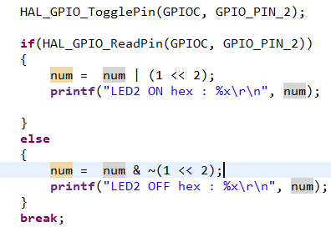
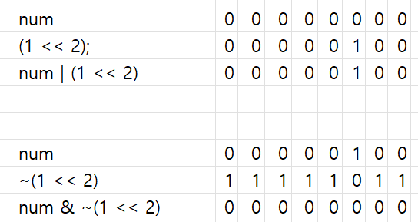
uint8_t
Notes:
/* USER CODE BEGIN Header */
/**
******************************************************************************
* @file : main.c
* @brief : Main program body
******************************************************************************
* @attention
*
* Copyright (c) 2023 STMicroelectronics.
* All rights reserved.
*
* This software is licensed under terms that can be found in the LICENSE file
* in the root directory of this software component.
* If no LICENSE file comes with this software, it is provided AS-IS.
*
******************************************************************************
*/
/* USER CODE END Header */
/* Includes ------------------------------------------------------------------*/
#include "main.h"
/* Private includes ----------------------------------------------------------*/
/* USER CODE BEGIN Includes */
/* USER CODE END Includes */
/* Private typedef -----------------------------------------------------------*/
/* USER CODE BEGIN PTD */
/* USER CODE END PTD */
/* Private define ------------------------------------------------------------*/
/* USER CODE BEGIN PD */
/* USER CODE END PD */
/* Private macro -------------------------------------------------------------*/
/* USER CODE BEGIN PM */
/* USER CODE END PM */
/* Private variables ---------------------------------------------------------*/
UART_HandleTypeDef huart1;
UART_HandleTypeDef huart2;
/* USER CODE BEGIN PV */
/* USER CODE END PV */
/* Private function prototypes -----------------------------------------------*/
void SystemClock_Config(void);
static void MX_GPIO_Init(void);
static void MX_USART1_UART_Init(void);
static void MX_USART2_UART_Init(void);
/* USER CODE BEGIN PFP */
/* USER CODE END PFP */
/* Private user code ---------------------------------------------------------*/
/* USER CODE BEGIN 0 */
int _write(int file, char * p, int len){ //
HAL_UART_Transmit(&huart1 , (uint8_t *)p, len, 10);
HAL_UART_Transmit(&huart2 , (uint8_t *)p, len, 10);
return len;
}
/* USER CODE END 0 */
/**
* @brief The application entry point.
* @retval int
*/
int main(void)
{
/* USER CODE BEGIN 1 */
/* USER CODE END 1 */
/* MCU Configuration--------------------------------------------------------*/
/* Reset of all peripherals, Initializes the Flash interface and the Systick. */
HAL_Init();
/* USER CODE BEGIN Init */
/* USER CODE END Init */
/* Configure the system clock */
SystemClock_Config();
/* USER CODE BEGIN SysInit */
/* USER CODE END SysInit */
/* Initialize all configured peripherals */
MX_GPIO_Init();
MX_USART1_UART_Init();
MX_USART2_UART_Init();
/* USER CODE BEGIN 2 */
uint8_t data = 0;
uint8_t num = 0;
/* USER CODE END 2 */
/* Infinite loop */
/* USER CODE BEGIN WHILE */
printf("connected\r\n");
while (1)
{
/* USER CODE END WHILE */
/* USER CODE BEGIN 3 */
HAL_UART_Receive(&huart1, &data, 1, 10);
switch(data)
{
case '0':
HAL_GPIO_TogglePin(GPIOC, GPIO_PIN_0);
if(HAL_GPIO_ReadPin(GPIOC, GPIO_PIN_0))
{
num = num | (1 << 0);
printf("LED0 ON hex : %x\r\n", num);
}
else
{
num = num & ~(1 << 0);
printf("LED0 OFF hex : %x\r\n", num);
}
break;
case '1':
HAL_GPIO_TogglePin(GPIOC, GPIO_PIN_1);
if(HAL_GPIO_ReadPin(GPIOC, GPIO_PIN_1))
{
num = num | (1 << 1);
printf("LED1 ON hex : %x\r\n", num);
}
else
{
num = num & ~(1 << 1);
printf("LED1 OFF hex : %x\r\n", num);
}
break;
case '2':
HAL_GPIO_TogglePin(GPIOC, GPIO_PIN_2);
if(HAL_GPIO_ReadPin(GPIOC, GPIO_PIN_2))
{
num = num | (1 << 2);
printf("LED2 ON hex : %x\r\n", num);
}
else
{
num = num & ~(1 << 2);
printf("LED2 OFF hex : %x\r\n", num);
}
break;
case '3':
HAL_GPIO_TogglePin(GPIOC, GPIO_PIN_3);
if(HAL_GPIO_ReadPin(GPIOC, GPIO_PIN_3))
{
num = num | (1 << 3);
printf("LED3 ON hex : %x\r\n", num);
}
else
{
num = num & ~(1 << 3);
printf("LED3 OFF hex : %x\r\n", num);
}
break;
case '4':
HAL_GPIO_TogglePin(GPIOC, GPIO_PIN_4);
if(HAL_GPIO_ReadPin(GPIOC, GPIO_PIN_4))
{
num = num | (1 << 4);
printf("LED4 ON hex : %x\r\n", num);
}
else
{
num = num & ~(1 << 4);
printf("LED4 OFF hex : %x\r\n", num);
}
break;
case '5':
HAL_GPIO_TogglePin(GPIOC, GPIO_PIN_5);
if(HAL_GPIO_ReadPin(GPIOC, GPIO_PIN_5))
{
num = num | (1 << 5);
printf("LED5 ON hex : %x\r\n", num);
}
else
{
num = num & ~(1 << 5);
printf("LED5 OFF hex : %x\r\n", num);
}
break;
case '6':
HAL_GPIO_TogglePin(GPIOC, GPIO_PIN_6);
if(HAL_GPIO_ReadPin(GPIOC, GPIO_PIN_6))
{
num = num | (1 << 6);
printf("LED6 ON hex : %x\r\n", num);
}
else
{
num = num & ~(1 << 6);
printf("LED6 OFF hex : %x\r\n", num);
}
break;
case '7':
HAL_GPIO_TogglePin(GPIOC, GPIO_PIN_7);
if(HAL_GPIO_ReadPin(GPIOC, GPIO_PIN_7))
{
num = num | (1 << 7);
printf("LED7 ON hex : %x\r\n", num);
}
else
{
num = num & ~(1 << 7);
printf("LED7 OFF hex : %x\r\n", num);
}
break;
}
data = 0;
}
/* USER CODE END 3 */
}
/**
* @brief System Clock Configuration
* @retval None
*/
void SystemClock_Config(void)
{
RCC_OscInitTypeDef RCC_OscInitStruct = {0};
RCC_ClkInitTypeDef RCC_ClkInitStruct = {0};
/** Configure the main internal regulator output voltage
*/
__HAL_RCC_PWR_CLK_ENABLE();
__HAL_PWR_VOLTAGESCALING_CONFIG(PWR_REGULATOR_VOLTAGE_SCALE1);
/** Initializes the RCC Oscillators according to the specified parameters
* in the RCC_OscInitTypeDef structure.
*/
RCC_OscInitStruct.OscillatorType = RCC_OSCILLATORTYPE_HSI;
RCC_OscInitStruct.HSIState = RCC_HSI_ON;
RCC_OscInitStruct.HSICalibrationValue = RCC_HSICALIBRATION_DEFAULT;
RCC_OscInitStruct.PLL.PLLState = RCC_PLL_NONE;
if (HAL_RCC_OscConfig(&RCC_OscInitStruct) != HAL_OK)
{
Error_Handler();
}
/** Initializes the CPU, AHB and APB buses clocks
*/
RCC_ClkInitStruct.ClockType = RCC_CLOCKTYPE_HCLK|RCC_CLOCKTYPE_SYSCLK
|RCC_CLOCKTYPE_PCLK1|RCC_CLOCKTYPE_PCLK2;
RCC_ClkInitStruct.SYSCLKSource = RCC_SYSCLKSOURCE_HSI;
RCC_ClkInitStruct.AHBCLKDivider = RCC_SYSCLK_DIV1;
RCC_ClkInitStruct.APB1CLKDivider = RCC_HCLK_DIV1;
RCC_ClkInitStruct.APB2CLKDivider = RCC_HCLK_DIV1;
if (HAL_RCC_ClockConfig(&RCC_ClkInitStruct, FLASH_LATENCY_0) != HAL_OK)
{
Error_Handler();
}
}
/**
* @brief USART1 Initialization Function
* @param None
* @retval None
*/
static void MX_USART1_UART_Init(void)
{
/* USER CODE BEGIN USART1_Init 0 */
/* USER CODE END USART1_Init 0 */
/* USER CODE BEGIN USART1_Init 1 */
/* USER CODE END USART1_Init 1 */
huart1.Instance = USART1;
huart1.Init.BaudRate = 115200;
huart1.Init.WordLength = UART_WORDLENGTH_8B;
huart1.Init.StopBits = UART_STOPBITS_1;
huart1.Init.Parity = UART_PARITY_NONE;
huart1.Init.Mode = UART_MODE_TX_RX;
huart1.Init.HwFlowCtl = UART_HWCONTROL_NONE;
huart1.Init.OverSampling = UART_OVERSAMPLING_16;
if (HAL_UART_Init(&huart1) != HAL_OK)
{
Error_Handler();
}
/* USER CODE BEGIN USART1_Init 2 */
/* USER CODE END USART1_Init 2 */
}
/**
* @brief USART2 Initialization Function
* @param None
* @retval None
*/
static void MX_USART2_UART_Init(void)
{
/* USER CODE BEGIN USART2_Init 0 */
/* USER CODE END USART2_Init 0 */
/* USER CODE BEGIN USART2_Init 1 */
/* USER CODE END USART2_Init 1 */
huart2.Instance = USART2;
huart2.Init.BaudRate = 115200;
huart2.Init.WordLength = UART_WORDLENGTH_8B;
huart2.Init.StopBits = UART_STOPBITS_1;
huart2.Init.Parity = UART_PARITY_NONE;
huart2.Init.Mode = UART_MODE_TX_RX;
huart2.Init.HwFlowCtl = UART_HWCONTROL_NONE;
huart2.Init.OverSampling = UART_OVERSAMPLING_16;
if (HAL_UART_Init(&huart2) != HAL_OK)
{
Error_Handler();
}
/* USER CODE BEGIN USART2_Init 2 */
/* USER CODE END USART2_Init 2 */
}
/**
* @brief GPIO Initialization Function
* @param None
* @retval None
*/
static void MX_GPIO_Init(void)
{
GPIO_InitTypeDef GPIO_InitStruct = {0};
/* USER CODE BEGIN MX_GPIO_Init_1 */
/* USER CODE END MX_GPIO_Init_1 */
/* GPIO Ports Clock Enable */
__HAL_RCC_GPIOC_CLK_ENABLE();
__HAL_RCC_GPIOA_CLK_ENABLE();
/*Configure GPIO pin Output Level */
HAL_GPIO_WritePin(GPIOC, LED0_Pin|LED1_Pin|LED2_Pin|LED3_Pin
|LED4_Pin|LED5_Pin|LED6_Pin|LED7_Pin, GPIO_PIN_RESET);
/*Configure GPIO pins : LED0_Pin LED1_Pin LED2_Pin LED3_Pin
LED4_Pin LED5_Pin LED6_Pin LED7_Pin */
GPIO_InitStruct.Pin = LED0_Pin|LED1_Pin|LED2_Pin|LED3_Pin
|LED4_Pin|LED5_Pin|LED6_Pin|LED7_Pin;
GPIO_InitStruct.Mode = GPIO_MODE_OUTPUT_PP;
GPIO_InitStruct.Pull = GPIO_NOPULL;
GPIO_InitStruct.Speed = GPIO_SPEED_FREQ_LOW;
HAL_GPIO_Init(GPIOC, &GPIO_InitStruct);
/* USER CODE BEGIN MX_GPIO_Init_2 */
/* USER CODE END MX_GPIO_Init_2 */
}
/* USER CODE BEGIN 4 */
/* USER CODE END 4 */
/**
* @brief This function is executed in case of error occurrence.
* @retval None
*/
void Error_Handler(void)
{
/* USER CODE BEGIN Error_Handler_Debug */
/* User can add his own implementation to report the HAL error return state */
__disable_irq();
while (1)
{
}
/* USER CODE END Error_Handler_Debug */
}
#ifdef USE_FULL_ASSERT
/**
* @brief Reports the name of the source file and the source line number
* where the assert_param error has occurred.
* @param file: pointer to the source file name
* @param line: assert_param error line source number
* @retval None
*/
void assert_failed(uint8_t *file, uint32_t line)
{
/* USER CODE BEGIN 6 */
/* User can add his own implementation to report the file name and line number,
ex: printf("Wrong parameters value: file %s on line %d\r\n", file, line) */
/* USER CODE END 6 */
}
#endif /* USE_FULL_ASSERT */

Slide 15
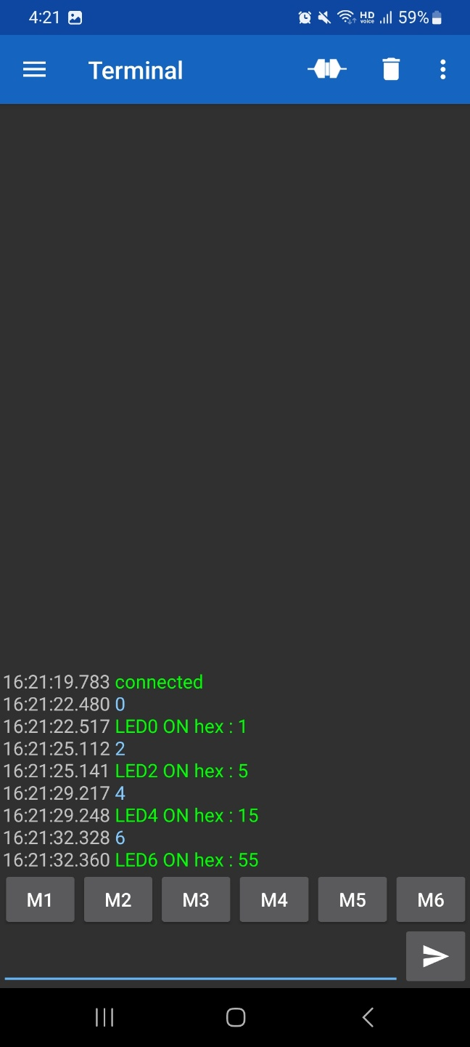
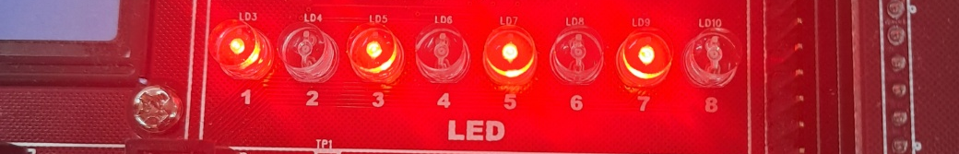
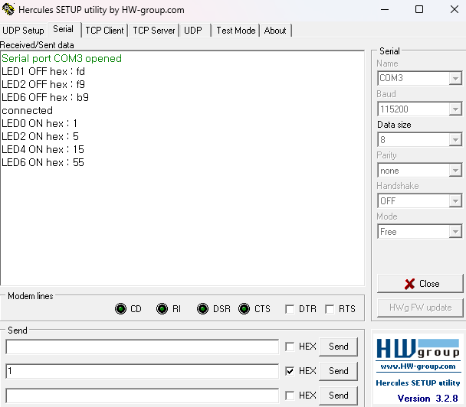
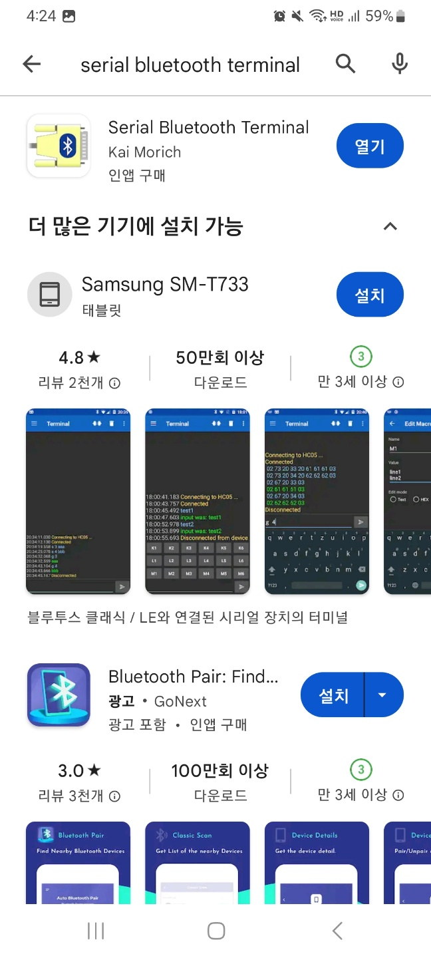
실행 결과
Notes:
/* USER CODE BEGIN Header */
/**
******************************************************************************
* @file : main.c
* @brief : Main program body
******************************************************************************
* @attention
*
* Copyright (c) 2023 STMicroelectronics.
* All rights reserved.
*
* This software is licensed under terms that can be found in the LICENSE file
* in the root directory of this software component.
* If no LICENSE file comes with this software, it is provided AS-IS.
*
******************************************************************************
*/
/* USER CODE END Header */
/* Includes ------------------------------------------------------------------*/
#include "main.h"
/* Private includes ----------------------------------------------------------*/
/* USER CODE BEGIN Includes */
/* USER CODE END Includes */
/* Private typedef -----------------------------------------------------------*/
/* USER CODE BEGIN PTD */
/* USER CODE END PTD */
/* Private define ------------------------------------------------------------*/
/* USER CODE BEGIN PD */
/* USER CODE END PD */
/* Private macro -------------------------------------------------------------*/
/* USER CODE BEGIN PM */
/* USER CODE END PM */
/* Private variables ---------------------------------------------------------*/
UART_HandleTypeDef huart1;
UART_HandleTypeDef huart2;
/* USER CODE BEGIN PV */
/* USER CODE END PV */
/* Private function prototypes -----------------------------------------------*/
void SystemClock_Config(void);
static void MX_GPIO_Init(void);
static void MX_USART1_UART_Init(void);
static void MX_USART2_UART_Init(void);
/* USER CODE BEGIN PFP */
/* USER CODE END PFP */
/* Private user code ---------------------------------------------------------*/
/* USER CODE BEGIN 0 */
int _write(int file, char * p, int len){ //
HAL_UART_Transmit(&huart1 , (uint8_t *)p, len, 10);
HAL_UART_Transmit(&huart2 , (uint8_t *)p, len, 10);
return len;
}
/* USER CODE END 0 */
/**
* @brief The application entry point.
* @retval int
*/
int main(void)
{
/* USER CODE BEGIN 1 */
/* USER CODE END 1 */
/* MCU Configuration--------------------------------------------------------*/
/* Reset of all peripherals, Initializes the Flash interface and the Systick. */
HAL_Init();
/* USER CODE BEGIN Init */
/* USER CODE END Init */
/* Configure the system clock */
SystemClock_Config();
/* USER CODE BEGIN SysInit */
/* USER CODE END SysInit */
/* Initialize all configured peripherals */
MX_GPIO_Init();
MX_USART1_UART_Init();
MX_USART2_UART_Init();
/* USER CODE BEGIN 2 */
uint8_t data = 0;
uint8_t num = 0;
/* USER CODE END 2 */
/* Infinite loop */
/* USER CODE BEGIN WHILE */
printf("connected\r\n");
while (1)
{
/* USER CODE END WHILE */
/* USER CODE BEGIN 3 */
HAL_UART_Receive(&huart1, &data, 1, 10);
switch(data)
{
case '0':
HAL_GPIO_TogglePin(GPIOC, GPIO_PIN_0);
if(HAL_GPIO_ReadPin(GPIOC, GPIO_PIN_0))
{
num = num | (1 << 0);
printf("LED0 ON hex : %x\r\n", num);
}
else
{
num = num & ~(1 << 0);
printf("LED0 OFF hex : %x\r\n", num);
}
break;
case '1':
HAL_GPIO_TogglePin(GPIOC, GPIO_PIN_1);
if(HAL_GPIO_ReadPin(GPIOC, GPIO_PIN_1))
{
num = num | (1 << 1);
printf("LED1 ON hex : %x\r\n", num);
}
else
{
num = num & ~(1 << 1);
printf("LED1 OFF hex : %x\r\n", num);
}
break;
case '2':
HAL_GPIO_TogglePin(GPIOC, GPIO_PIN_2);
if(HAL_GPIO_ReadPin(GPIOC, GPIO_PIN_2))
{
num = num | (1 << 2);
printf("LED2 ON hex : %x\r\n", num);
}
else
{
num = num & ~(1 << 2);
printf("LED2 OFF hex : %x\r\n", num);
}
break;
case '3':
HAL_GPIO_TogglePin(GPIOC, GPIO_PIN_3);
if(HAL_GPIO_ReadPin(GPIOC, GPIO_PIN_3))
{
num = num | (1 << 3);
printf("LED3 ON hex : %x\r\n", num);
}
else
{
num = num & ~(1 << 3);
printf("LED3 OFF hex : %x\r\n", num);
}
break;
case '4':
HAL_GPIO_TogglePin(GPIOC, GPIO_PIN_4);
if(HAL_GPIO_ReadPin(GPIOC, GPIO_PIN_4))
{
num = num | (1 << 4);
printf("LED4 ON hex : %x\r\n", num);
}
else
{
num = num & ~(1 << 4);
printf("LED4 OFF hex : %x\r\n", num);
}
break;
case '5':
HAL_GPIO_TogglePin(GPIOC, GPIO_PIN_5);
if(HAL_GPIO_ReadPin(GPIOC, GPIO_PIN_5))
{
num = num | (1 << 5);
printf("LED5 ON hex : %x\r\n", num);
}
else
{
num = num & ~(1 << 5);
printf("LED5 OFF hex : %x\r\n", num);
}
break;
case '6':
HAL_GPIO_TogglePin(GPIOC, GPIO_PIN_6);
if(HAL_GPIO_ReadPin(GPIOC, GPIO_PIN_6))
{
num = num | (1 << 6);
printf("LED6 ON hex : %x\r\n", num);
}
else
{
num = num & ~(1 << 6);
printf("LED6 OFF hex : %x\r\n", num);
}
break;
case '7':
HAL_GPIO_TogglePin(GPIOC, GPIO_PIN_7);
if(HAL_GPIO_ReadPin(GPIOC, GPIO_PIN_7))
{
num = num | (1 << 7);
printf("LED7 ON hex : %x\r\n", num);
}
else
{
num = num & ~(1 << 7);
printf("LED7 OFF hex : %x\r\n", num);
}
break;
}
data = 0;
}
/* USER CODE END 3 */
}
/**
* @brief System Clock Configuration
* @retval None
*/
void SystemClock_Config(void)
{
RCC_OscInitTypeDef RCC_OscInitStruct = {0};
RCC_ClkInitTypeDef RCC_ClkInitStruct = {0};
/** Configure the main internal regulator output voltage
*/
__HAL_RCC_PWR_CLK_ENABLE();
__HAL_PWR_VOLTAGESCALING_CONFIG(PWR_REGULATOR_VOLTAGE_SCALE1);
/** Initializes the RCC Oscillators according to the specified parameters
* in the RCC_OscInitTypeDef structure.
*/
RCC_OscInitStruct.OscillatorType = RCC_OSCILLATORTYPE_HSI;
RCC_OscInitStruct.HSIState = RCC_HSI_ON;
RCC_OscInitStruct.HSICalibrationValue = RCC_HSICALIBRATION_DEFAULT;
RCC_OscInitStruct.PLL.PLLState = RCC_PLL_NONE;
if (HAL_RCC_OscConfig(&RCC_OscInitStruct) != HAL_OK)
{
Error_Handler();
}
/** Initializes the CPU, AHB and APB buses clocks
*/
RCC_ClkInitStruct.ClockType = RCC_CLOCKTYPE_HCLK|RCC_CLOCKTYPE_SYSCLK
|RCC_CLOCKTYPE_PCLK1|RCC_CLOCKTYPE_PCLK2;
RCC_ClkInitStruct.SYSCLKSource = RCC_SYSCLKSOURCE_HSI;
RCC_ClkInitStruct.AHBCLKDivider = RCC_SYSCLK_DIV1;
RCC_ClkInitStruct.APB1CLKDivider = RCC_HCLK_DIV1;
RCC_ClkInitStruct.APB2CLKDivider = RCC_HCLK_DIV1;
if (HAL_RCC_ClockConfig(&RCC_ClkInitStruct, FLASH_LATENCY_0) != HAL_OK)
{
Error_Handler();
}
}
/**
* @brief USART1 Initialization Function
* @param None
* @retval None
*/
static void MX_USART1_UART_Init(void)
{
/* USER CODE BEGIN USART1_Init 0 */
/* USER CODE END USART1_Init 0 */
/* USER CODE BEGIN USART1_Init 1 */
/* USER CODE END USART1_Init 1 */
huart1.Instance = USART1;
huart1.Init.BaudRate = 115200;
huart1.Init.WordLength = UART_WORDLENGTH_8B;
huart1.Init.StopBits = UART_STOPBITS_1;
huart1.Init.Parity = UART_PARITY_NONE;
huart1.Init.Mode = UART_MODE_TX_RX;
huart1.Init.HwFlowCtl = UART_HWCONTROL_NONE;
huart1.Init.OverSampling = UART_OVERSAMPLING_16;
if (HAL_UART_Init(&huart1) != HAL_OK)
{
Error_Handler();
}
/* USER CODE BEGIN USART1_Init 2 */
/* USER CODE END USART1_Init 2 */
}
/**
* @brief USART2 Initialization Function
* @param None
* @retval None
*/
static void MX_USART2_UART_Init(void)
{
/* USER CODE BEGIN USART2_Init 0 */
/* USER CODE END USART2_Init 0 */
/* USER CODE BEGIN USART2_Init 1 */
/* USER CODE END USART2_Init 1 */
huart2.Instance = USART2;
huart2.Init.BaudRate = 115200;
huart2.Init.WordLength = UART_WORDLENGTH_8B;
huart2.Init.StopBits = UART_STOPBITS_1;
huart2.Init.Parity = UART_PARITY_NONE;
huart2.Init.Mode = UART_MODE_TX_RX;
huart2.Init.HwFlowCtl = UART_HWCONTROL_NONE;
huart2.Init.OverSampling = UART_OVERSAMPLING_16;
if (HAL_UART_Init(&huart2) != HAL_OK)
{
Error_Handler();
}
/* USER CODE BEGIN USART2_Init 2 */
/* USER CODE END USART2_Init 2 */
}
/**
* @brief GPIO Initialization Function
* @param None
* @retval None
*/
static void MX_GPIO_Init(void)
{
GPIO_InitTypeDef GPIO_InitStruct = {0};
/* USER CODE BEGIN MX_GPIO_Init_1 */
/* USER CODE END MX_GPIO_Init_1 */
/* GPIO Ports Clock Enable */
__HAL_RCC_GPIOC_CLK_ENABLE();
__HAL_RCC_GPIOA_CLK_ENABLE();
/*Configure GPIO pin Output Level */
HAL_GPIO_WritePin(GPIOC, LED0_Pin|LED1_Pin|LED2_Pin|LED3_Pin
|LED4_Pin|LED5_Pin|LED6_Pin|LED7_Pin, GPIO_PIN_RESET);
/*Configure GPIO pins : LED0_Pin LED1_Pin LED2_Pin LED3_Pin
LED4_Pin LED5_Pin LED6_Pin LED7_Pin */
GPIO_InitStruct.Pin = LED0_Pin|LED1_Pin|LED2_Pin|LED3_Pin
|LED4_Pin|LED5_Pin|LED6_Pin|LED7_Pin;
GPIO_InitStruct.Mode = GPIO_MODE_OUTPUT_PP;
GPIO_InitStruct.Pull = GPIO_NOPULL;
GPIO_InitStruct.Speed = GPIO_SPEED_FREQ_LOW;
HAL_GPIO_Init(GPIOC, &GPIO_InitStruct);
/* USER CODE BEGIN MX_GPIO_Init_2 */
/* USER CODE END MX_GPIO_Init_2 */
}
/* USER CODE BEGIN 4 */
/* USER CODE END 4 */
/**
* @brief This function is executed in case of error occurrence.
* @retval None
*/
void Error_Handler(void)
{
/* USER CODE BEGIN Error_Handler_Debug */
/* User can add his own implementation to report the HAL error return state */
__disable_irq();
while (1)
{
}
/* USER CODE END Error_Handler_Debug */
}
#ifdef USE_FULL_ASSERT
/**
* @brief Reports the name of the source file and the source line number
* where the assert_param error has occurred.
* @param file: pointer to the source file name
* @param line: assert_param error line source number
* @retval None
*/
void assert_failed(uint8_t *file, uint32_t line)
{
/* USER CODE BEGIN 6 */
/* User can add his own implementation to report the file name and line number,
ex: printf("Wrong parameters value: file %s on line %d\r\n", file, line) */
/* USER CODE END 6 */
}
#endif /* USE_FULL_ASSERT */

Slide 16
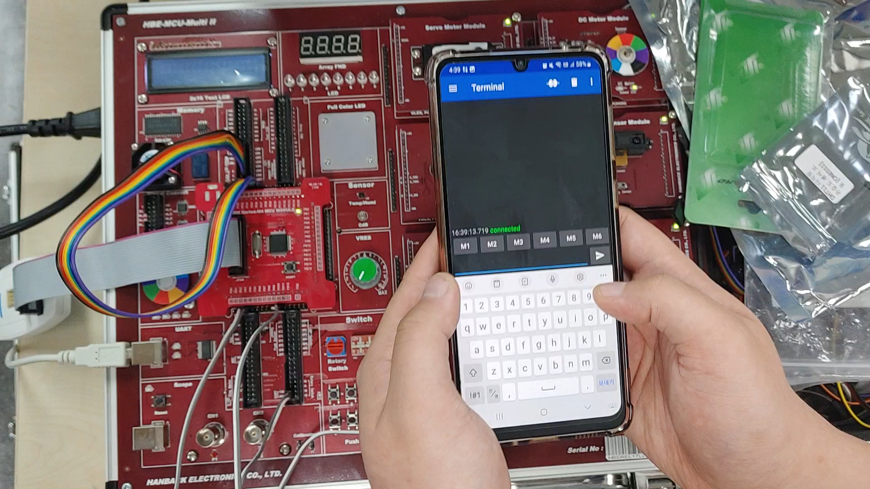

Slide 17
HC06 모듈 사용하기
Notes:
/* USER CODE BEGIN Header */
/**
******************************************************************************
* @file : main.c
* @brief : Main program body
******************************************************************************
* @attention
*
* Copyright (c) 2023 STMicroelectronics.
* All rights reserved.
*
* This software is licensed under terms that can be found in the LICENSE file
* in the root directory of this software component.
* If no LICENSE file comes with this software, it is provided AS-IS.
*
******************************************************************************
*/
/* USER CODE END Header */
/* Includes ------------------------------------------------------------------*/
#include "main.h"
/* Private includes ----------------------------------------------------------*/
/* USER CODE BEGIN Includes */
/* USER CODE END Includes */
/* Private typedef -----------------------------------------------------------*/
/* USER CODE BEGIN PTD */
/* USER CODE END PTD */
/* Private define ------------------------------------------------------------*/
/* USER CODE BEGIN PD */
/* USER CODE END PD */
/* Private macro -------------------------------------------------------------*/
/* USER CODE BEGIN PM */
/* USER CODE END PM */
/* Private variables ---------------------------------------------------------*/
UART_HandleTypeDef huart1;
UART_HandleTypeDef huart2;
/* USER CODE BEGIN PV */
/* USER CODE END PV */
/* Private function prototypes -----------------------------------------------*/
void SystemClock_Config(void);
static void MX_GPIO_Init(void);
static void MX_USART1_UART_Init(void);
static void MX_USART2_UART_Init(void);
/* USER CODE BEGIN PFP */
/* USER CODE END PFP */
/* Private user code ---------------------------------------------------------*/
/* USER CODE BEGIN 0 */
int _write(int file, char * p, int len){ //
HAL_UART_Transmit(&huart1 , (uint8_t *)p, len, 10);
HAL_UART_Transmit(&huart2 , (uint8_t *)p, len, 10);
return len;
}
/* USER CODE END 0 */
/**
* @brief The application entry point.
* @retval int
*/
int main(void)
{
/* USER CODE BEGIN 1 */
/* USER CODE END 1 */
/* MCU Configuration--------------------------------------------------------*/
/* Reset of all peripherals, Initializes the Flash interface and the Systick. */
HAL_Init();
/* USER CODE BEGIN Init */
/* USER CODE END Init */
/* Configure the system clock */
SystemClock_Config();
/* USER CODE BEGIN SysInit */
/* USER CODE END SysInit */
/* Initialize all configured peripherals */
MX_GPIO_Init();
MX_USART1_UART_Init();
MX_USART2_UART_Init();
/* USER CODE BEGIN 2 */
uint8_t data = 0;
uint8_t num = 0;
/* USER CODE END 2 */
/* Infinite loop */
/* USER CODE BEGIN WHILE */
printf("connected\r\n");
while (1)
{
/* USER CODE END WHILE */
/* USER CODE BEGIN 3 */
HAL_UART_Receive(&huart1, &data, 1, 10);
switch(data)
{
case '0':
HAL_GPIO_TogglePin(GPIOC, GPIO_PIN_0);
if(HAL_GPIO_ReadPin(GPIOC, GPIO_PIN_0))
{
num = num | (1 << 0);
printf("LED0 ON hex : %x\r\n", num);
}
else
{
num = num & ~(1 << 0);
printf("LED0 OFF hex : %x\r\n", num);
}
break;
case '1':
HAL_GPIO_TogglePin(GPIOC, GPIO_PIN_1);
if(HAL_GPIO_ReadPin(GPIOC, GPIO_PIN_1))
{
num = num | (1 << 1);
printf("LED1 ON hex : %x\r\n", num);
}
else
{
num = num & ~(1 << 1);
printf("LED1 OFF hex : %x\r\n", num);
}
break;
case '2':
HAL_GPIO_TogglePin(GPIOC, GPIO_PIN_2);
if(HAL_GPIO_ReadPin(GPIOC, GPIO_PIN_2))
{
num = num | (1 << 2);
printf("LED2 ON hex : %x\r\n", num);
}
else
{
num = num & ~(1 << 2);
printf("LED2 OFF hex : %x\r\n", num);
}
break;
case '3':
HAL_GPIO_TogglePin(GPIOC, GPIO_PIN_3);
if(HAL_GPIO_ReadPin(GPIOC, GPIO_PIN_3))
{
num = num | (1 << 3);
printf("LED3 ON hex : %x\r\n", num);
}
else
{
num = num & ~(1 << 3);
printf("LED3 OFF hex : %x\r\n", num);
}
break;
case '4':
HAL_GPIO_TogglePin(GPIOC, GPIO_PIN_4);
if(HAL_GPIO_ReadPin(GPIOC, GPIO_PIN_4))
{
num = num | (1 << 4);
printf("LED4 ON hex : %x\r\n", num);
}
else
{
num = num & ~(1 << 4);
printf("LED4 OFF hex : %x\r\n", num);
}
break;
case '5':
HAL_GPIO_TogglePin(GPIOC, GPIO_PIN_5);
if(HAL_GPIO_ReadPin(GPIOC, GPIO_PIN_5))
{
num = num | (1 << 5);
printf("LED5 ON hex : %x\r\n", num);
}
else
{
num = num & ~(1 << 5);
printf("LED5 OFF hex : %x\r\n", num);
}
break;
case '6':
HAL_GPIO_TogglePin(GPIOC, GPIO_PIN_6);
if(HAL_GPIO_ReadPin(GPIOC, GPIO_PIN_6))
{
num = num | (1 << 6);
printf("LED6 ON hex : %x\r\n", num);
}
else
{
num = num & ~(1 << 6);
printf("LED6 OFF hex : %x\r\n", num);
}
break;
case '7':
HAL_GPIO_TogglePin(GPIOC, GPIO_PIN_7);
if(HAL_GPIO_ReadPin(GPIOC, GPIO_PIN_7))
{
num = num | (1 << 7);
printf("LED7 ON hex : %x\r\n", num);
}
else
{
num = num & ~(1 << 7);
printf("LED7 OFF hex : %x\r\n", num);
}
break;
}
data = 0;
}
/* USER CODE END 3 */
}
/**
* @brief System Clock Configuration
* @retval None
*/
void SystemClock_Config(void)
{
RCC_OscInitTypeDef RCC_OscInitStruct = {0};
RCC_ClkInitTypeDef RCC_ClkInitStruct = {0};
/** Configure the main internal regulator output voltage
*/
__HAL_RCC_PWR_CLK_ENABLE();
__HAL_PWR_VOLTAGESCALING_CONFIG(PWR_REGULATOR_VOLTAGE_SCALE1);
/** Initializes the RCC Oscillators according to the specified parameters
* in the RCC_OscInitTypeDef structure.
*/
RCC_OscInitStruct.OscillatorType = RCC_OSCILLATORTYPE_HSI;
RCC_OscInitStruct.HSIState = RCC_HSI_ON;
RCC_OscInitStruct.HSICalibrationValue = RCC_HSICALIBRATION_DEFAULT;
RCC_OscInitStruct.PLL.PLLState = RCC_PLL_NONE;
if (HAL_RCC_OscConfig(&RCC_OscInitStruct) != HAL_OK)
{
Error_Handler();
}
/** Initializes the CPU, AHB and APB buses clocks
*/
RCC_ClkInitStruct.ClockType = RCC_CLOCKTYPE_HCLK|RCC_CLOCKTYPE_SYSCLK
|RCC_CLOCKTYPE_PCLK1|RCC_CLOCKTYPE_PCLK2;
RCC_ClkInitStruct.SYSCLKSource = RCC_SYSCLKSOURCE_HSI;
RCC_ClkInitStruct.AHBCLKDivider = RCC_SYSCLK_DIV1;
RCC_ClkInitStruct.APB1CLKDivider = RCC_HCLK_DIV1;
RCC_ClkInitStruct.APB2CLKDivider = RCC_HCLK_DIV1;
if (HAL_RCC_ClockConfig(&RCC_ClkInitStruct, FLASH_LATENCY_0) != HAL_OK)
{
Error_Handler();
}
}
/**
* @brief USART1 Initialization Function
* @param None
* @retval None
*/
static void MX_USART1_UART_Init(void)
{
/* USER CODE BEGIN USART1_Init 0 */
/* USER CODE END USART1_Init 0 */
/* USER CODE BEGIN USART1_Init 1 */
/* USER CODE END USART1_Init 1 */
huart1.Instance = USART1;
huart1.Init.BaudRate = 115200;
huart1.Init.WordLength = UART_WORDLENGTH_8B;
huart1.Init.StopBits = UART_STOPBITS_1;
huart1.Init.Parity = UART_PARITY_NONE;
huart1.Init.Mode = UART_MODE_TX_RX;
huart1.Init.HwFlowCtl = UART_HWCONTROL_NONE;
huart1.Init.OverSampling = UART_OVERSAMPLING_16;
if (HAL_UART_Init(&huart1) != HAL_OK)
{
Error_Handler();
}
/* USER CODE BEGIN USART1_Init 2 */
/* USER CODE END USART1_Init 2 */
}
/**
* @brief USART2 Initialization Function
* @param None
* @retval None
*/
static void MX_USART2_UART_Init(void)
{
/* USER CODE BEGIN USART2_Init 0 */
/* USER CODE END USART2_Init 0 */
/* USER CODE BEGIN USART2_Init 1 */
/* USER CODE END USART2_Init 1 */
huart2.Instance = USART2;
huart2.Init.BaudRate = 115200;
huart2.Init.WordLength = UART_WORDLENGTH_8B;
huart2.Init.StopBits = UART_STOPBITS_1;
huart2.Init.Parity = UART_PARITY_NONE;
huart2.Init.Mode = UART_MODE_TX_RX;
huart2.Init.HwFlowCtl = UART_HWCONTROL_NONE;
huart2.Init.OverSampling = UART_OVERSAMPLING_16;
if (HAL_UART_Init(&huart2) != HAL_OK)
{
Error_Handler();
}
/* USER CODE BEGIN USART2_Init 2 */
/* USER CODE END USART2_Init 2 */
}
/**
* @brief GPIO Initialization Function
* @param None
* @retval None
*/
static void MX_GPIO_Init(void)
{
GPIO_InitTypeDef GPIO_InitStruct = {0};
/* USER CODE BEGIN MX_GPIO_Init_1 */
/* USER CODE END MX_GPIO_Init_1 */
/* GPIO Ports Clock Enable */
__HAL_RCC_GPIOC_CLK_ENABLE();
__HAL_RCC_GPIOA_CLK_ENABLE();
/*Configure GPIO pin Output Level */
HAL_GPIO_WritePin(GPIOC, LED0_Pin|LED1_Pin|LED2_Pin|LED3_Pin
|LED4_Pin|LED5_Pin|LED6_Pin|LED7_Pin, GPIO_PIN_RESET);
/*Configure GPIO pins : LED0_Pin LED1_Pin LED2_Pin LED3_Pin
LED4_Pin LED5_Pin LED6_Pin LED7_Pin */
GPIO_InitStruct.Pin = LED0_Pin|LED1_Pin|LED2_Pin|LED3_Pin
|LED4_Pin|LED5_Pin|LED6_Pin|LED7_Pin;
GPIO_InitStruct.Mode = GPIO_MODE_OUTPUT_PP;
GPIO_InitStruct.Pull = GPIO_NOPULL;
GPIO_InitStruct.Speed = GPIO_SPEED_FREQ_LOW;
HAL_GPIO_Init(GPIOC, &GPIO_InitStruct);
/* USER CODE BEGIN MX_GPIO_Init_2 */
/* USER CODE END MX_GPIO_Init_2 */
}
/* USER CODE BEGIN 4 */
/* USER CODE END 4 */
/**
* @brief This function is executed in case of error occurrence.
* @retval None
*/
void Error_Handler(void)
{
/* USER CODE BEGIN Error_Handler_Debug */
/* User can add his own implementation to report the HAL error return state */
__disable_irq();
while (1)
{
}
/* USER CODE END Error_Handler_Debug */
}
#ifdef USE_FULL_ASSERT
/**
* @brief Reports the name of the source file and the source line number
* where the assert_param error has occurred.
* @param file: pointer to the source file name
* @param line: assert_param error line source number
* @retval None
*/
void assert_failed(uint8_t *file, uint32_t line)
{
/* USER CODE BEGIN 6 */
/* User can add his own implementation to report the file name and line number,
ex: printf("Wrong parameters value: file %s on line %d\r\n", file, line) */
/* USER CODE END 6 */
}
#endif /* USE_FULL_ASSERT */

Slide 18
부록
NUCLEO-429ZI 보드로
HC-06 블루투스 모듈 연결하여
LED 제어하기
Notes:
/* USER CODE BEGIN Header */
/**
******************************************************************************
* @file : main.c
* @brief : Main program body
******************************************************************************
* @attention
*
* Copyright (c) 2023 STMicroelectronics.
* All rights reserved.
*
* This software is licensed under terms that can be found in the LICENSE file
* in the root directory of this software component.
* If no LICENSE file comes with this software, it is provided AS-IS.
*
******************************************************************************
*/
/* USER CODE END Header */
/* Includes ------------------------------------------------------------------*/
#include "main.h"
/* Private includes ----------------------------------------------------------*/
/* USER CODE BEGIN Includes */
/* USER CODE END Includes */
/* Private typedef -----------------------------------------------------------*/
/* USER CODE BEGIN PTD */
/* USER CODE END PTD */
/* Private define ------------------------------------------------------------*/
/* USER CODE BEGIN PD */
/* USER CODE END PD */
/* Private macro -------------------------------------------------------------*/
/* USER CODE BEGIN PM */
/* USER CODE END PM */
/* Private variables ---------------------------------------------------------*/
UART_HandleTypeDef huart1;
UART_HandleTypeDef huart2;
/* USER CODE BEGIN PV */
/* USER CODE END PV */
/* Private function prototypes -----------------------------------------------*/
void SystemClock_Config(void);
static void MX_GPIO_Init(void);
static void MX_USART1_UART_Init(void);
static void MX_USART2_UART_Init(void);
/* USER CODE BEGIN PFP */
/* USER CODE END PFP */
/* Private user code ---------------------------------------------------------*/
/* USER CODE BEGIN 0 */
int _write(int file, char * p, int len){ //
HAL_UART_Transmit(&huart1 , (uint8_t *)p, len, 10);
HAL_UART_Transmit(&huart2 , (uint8_t *)p, len, 10);
return len;
}
/* USER CODE END 0 */
/**
* @brief The application entry point.
* @retval int
*/
int main(void)
{
/* USER CODE BEGIN 1 */
/* USER CODE END 1 */
/* MCU Configuration--------------------------------------------------------*/
/* Reset of all peripherals, Initializes the Flash interface and the Systick. */
HAL_Init();
/* USER CODE BEGIN Init */
/* USER CODE END Init */
/* Configure the system clock */
SystemClock_Config();
/* USER CODE BEGIN SysInit */
/* USER CODE END SysInit */
/* Initialize all configured peripherals */
MX_GPIO_Init();
MX_USART1_UART_Init();
MX_USART2_UART_Init();
/* USER CODE BEGIN 2 */
uint8_t data = 0;
uint8_t num = 0;
/* USER CODE END 2 */
/* Infinite loop */
/* USER CODE BEGIN WHILE */
printf("connected\r\n");
while (1)
{
/* USER CODE END WHILE */
/* USER CODE BEGIN 3 */
HAL_UART_Receive(&huart1, &data, 1, 10);
switch(data)
{
case '0':
HAL_GPIO_TogglePin(GPIOC, GPIO_PIN_0);
if(HAL_GPIO_ReadPin(GPIOC, GPIO_PIN_0))
{
num = num | (1 << 0);
printf("LED0 ON hex : %x\r\n", num);
}
else
{
num = num & ~(1 << 0);
printf("LED0 OFF hex : %x\r\n", num);
}
break;
case '1':
HAL_GPIO_TogglePin(GPIOC, GPIO_PIN_1);
if(HAL_GPIO_ReadPin(GPIOC, GPIO_PIN_1))
{
num = num | (1 << 1);
printf("LED1 ON hex : %x\r\n", num);
}
else
{
num = num & ~(1 << 1);
printf("LED1 OFF hex : %x\r\n", num);
}
break;
case '2':
HAL_GPIO_TogglePin(GPIOC, GPIO_PIN_2);
if(HAL_GPIO_ReadPin(GPIOC, GPIO_PIN_2))
{
num = num | (1 << 2);
printf("LED2 ON hex : %x\r\n", num);
}
else
{
num = num & ~(1 << 2);
printf("LED2 OFF hex : %x\r\n", num);
}
break;
case '3':
HAL_GPIO_TogglePin(GPIOC, GPIO_PIN_3);
if(HAL_GPIO_ReadPin(GPIOC, GPIO_PIN_3))
{
num = num | (1 << 3);
printf("LED3 ON hex : %x\r\n", num);
}
else
{
num = num & ~(1 << 3);
printf("LED3 OFF hex : %x\r\n", num);
}
break;
case '4':
HAL_GPIO_TogglePin(GPIOC, GPIO_PIN_4);
if(HAL_GPIO_ReadPin(GPIOC, GPIO_PIN_4))
{
num = num | (1 << 4);
printf("LED4 ON hex : %x\r\n", num);
}
else
{
num = num & ~(1 << 4);
printf("LED4 OFF hex : %x\r\n", num);
}
break;
case '5':
HAL_GPIO_TogglePin(GPIOC, GPIO_PIN_5);
if(HAL_GPIO_ReadPin(GPIOC, GPIO_PIN_5))
{
num = num | (1 << 5);
printf("LED5 ON hex : %x\r\n", num);
}
else
{
num = num & ~(1 << 5);
printf("LED5 OFF hex : %x\r\n", num);
}
break;
case '6':
HAL_GPIO_TogglePin(GPIOC, GPIO_PIN_6);
if(HAL_GPIO_ReadPin(GPIOC, GPIO_PIN_6))
{
num = num | (1 << 6);
printf("LED6 ON hex : %x\r\n", num);
}
else
{
num = num & ~(1 << 6);
printf("LED6 OFF hex : %x\r\n", num);
}
break;
case '7':
HAL_GPIO_TogglePin(GPIOC, GPIO_PIN_7);
if(HAL_GPIO_ReadPin(GPIOC, GPIO_PIN_7))
{
num = num | (1 << 7);
printf("LED7 ON hex : %x\r\n", num);
}
else
{
num = num & ~(1 << 7);
printf("LED7 OFF hex : %x\r\n", num);
}
break;
}
data = 0;
}
/* USER CODE END 3 */
}
/**
* @brief System Clock Configuration
* @retval None
*/
void SystemClock_Config(void)
{
RCC_OscInitTypeDef RCC_OscInitStruct = {0};
RCC_ClkInitTypeDef RCC_ClkInitStruct = {0};
/** Configure the main internal regulator output voltage
*/
__HAL_RCC_PWR_CLK_ENABLE();
__HAL_PWR_VOLTAGESCALING_CONFIG(PWR_REGULATOR_VOLTAGE_SCALE1);
/** Initializes the RCC Oscillators according to the specified parameters
* in the RCC_OscInitTypeDef structure.
*/
RCC_OscInitStruct.OscillatorType = RCC_OSCILLATORTYPE_HSI;
RCC_OscInitStruct.HSIState = RCC_HSI_ON;
RCC_OscInitStruct.HSICalibrationValue = RCC_HSICALIBRATION_DEFAULT;
RCC_OscInitStruct.PLL.PLLState = RCC_PLL_NONE;
if (HAL_RCC_OscConfig(&RCC_OscInitStruct) != HAL_OK)
{
Error_Handler();
}
/** Initializes the CPU, AHB and APB buses clocks
*/
RCC_ClkInitStruct.ClockType = RCC_CLOCKTYPE_HCLK|RCC_CLOCKTYPE_SYSCLK
|RCC_CLOCKTYPE_PCLK1|RCC_CLOCKTYPE_PCLK2;
RCC_ClkInitStruct.SYSCLKSource = RCC_SYSCLKSOURCE_HSI;
RCC_ClkInitStruct.AHBCLKDivider = RCC_SYSCLK_DIV1;
RCC_ClkInitStruct.APB1CLKDivider = RCC_HCLK_DIV1;
RCC_ClkInitStruct.APB2CLKDivider = RCC_HCLK_DIV1;
if (HAL_RCC_ClockConfig(&RCC_ClkInitStruct, FLASH_LATENCY_0) != HAL_OK)
{
Error_Handler();
}
}
/**
* @brief USART1 Initialization Function
* @param None
* @retval None
*/
static void MX_USART1_UART_Init(void)
{
/* USER CODE BEGIN USART1_Init 0 */
/* USER CODE END USART1_Init 0 */
/* USER CODE BEGIN USART1_Init 1 */
/* USER CODE END USART1_Init 1 */
huart1.Instance = USART1;
huart1.Init.BaudRate = 115200;
huart1.Init.WordLength = UART_WORDLENGTH_8B;
huart1.Init.StopBits = UART_STOPBITS_1;
huart1.Init.Parity = UART_PARITY_NONE;
huart1.Init.Mode = UART_MODE_TX_RX;
huart1.Init.HwFlowCtl = UART_HWCONTROL_NONE;
huart1.Init.OverSampling = UART_OVERSAMPLING_16;
if (HAL_UART_Init(&huart1) != HAL_OK)
{
Error_Handler();
}
/* USER CODE BEGIN USART1_Init 2 */
/* USER CODE END USART1_Init 2 */
}
/**
* @brief USART2 Initialization Function
* @param None
* @retval None
*/
static void MX_USART2_UART_Init(void)
{
/* USER CODE BEGIN USART2_Init 0 */
/* USER CODE END USART2_Init 0 */
/* USER CODE BEGIN USART2_Init 1 */
/* USER CODE END USART2_Init 1 */
huart2.Instance = USART2;
huart2.Init.BaudRate = 115200;
huart2.Init.WordLength = UART_WORDLENGTH_8B;
huart2.Init.StopBits = UART_STOPBITS_1;
huart2.Init.Parity = UART_PARITY_NONE;
huart2.Init.Mode = UART_MODE_TX_RX;
huart2.Init.HwFlowCtl = UART_HWCONTROL_NONE;
huart2.Init.OverSampling = UART_OVERSAMPLING_16;
if (HAL_UART_Init(&huart2) != HAL_OK)
{
Error_Handler();
}
/* USER CODE BEGIN USART2_Init 2 */
/* USER CODE END USART2_Init 2 */
}
/**
* @brief GPIO Initialization Function
* @param None
* @retval None
*/
static void MX_GPIO_Init(void)
{
GPIO_InitTypeDef GPIO_InitStruct = {0};
/* USER CODE BEGIN MX_GPIO_Init_1 */
/* USER CODE END MX_GPIO_Init_1 */
/* GPIO Ports Clock Enable */
__HAL_RCC_GPIOC_CLK_ENABLE();
__HAL_RCC_GPIOA_CLK_ENABLE();
/*Configure GPIO pin Output Level */
HAL_GPIO_WritePin(GPIOC, LED0_Pin|LED1_Pin|LED2_Pin|LED3_Pin
|LED4_Pin|LED5_Pin|LED6_Pin|LED7_Pin, GPIO_PIN_RESET);
/*Configure GPIO pins : LED0_Pin LED1_Pin LED2_Pin LED3_Pin
LED4_Pin LED5_Pin LED6_Pin LED7_Pin */
GPIO_InitStruct.Pin = LED0_Pin|LED1_Pin|LED2_Pin|LED3_Pin
|LED4_Pin|LED5_Pin|LED6_Pin|LED7_Pin;
GPIO_InitStruct.Mode = GPIO_MODE_OUTPUT_PP;
GPIO_InitStruct.Pull = GPIO_NOPULL;
GPIO_InitStruct.Speed = GPIO_SPEED_FREQ_LOW;
HAL_GPIO_Init(GPIOC, &GPIO_InitStruct);
/* USER CODE BEGIN MX_GPIO_Init_2 */
/* USER CODE END MX_GPIO_Init_2 */
}
/* USER CODE BEGIN 4 */
/* USER CODE END 4 */
/**
* @brief This function is executed in case of error occurrence.
* @retval None
*/
void Error_Handler(void)
{
/* USER CODE BEGIN Error_Handler_Debug */
/* User can add his own implementation to report the HAL error return state */
__disable_irq();
while (1)
{
}
/* USER CODE END Error_Handler_Debug */
}
#ifdef USE_FULL_ASSERT
/**
* @brief Reports the name of the source file and the source line number
* where the assert_param error has occurred.
* @param file: pointer to the source file name
* @param line: assert_param error line source number
* @retval None
*/
void assert_failed(uint8_t *file, uint32_t line)
{
/* USER CODE BEGIN 6 */
/* User can add his own implementation to report the file name and line number,
ex: printf("Wrong parameters value: file %s on line %d\r\n", file, line) */
/* USER CODE END 6 */
}
#endif /* USE_FULL_ASSERT */

Slide 19
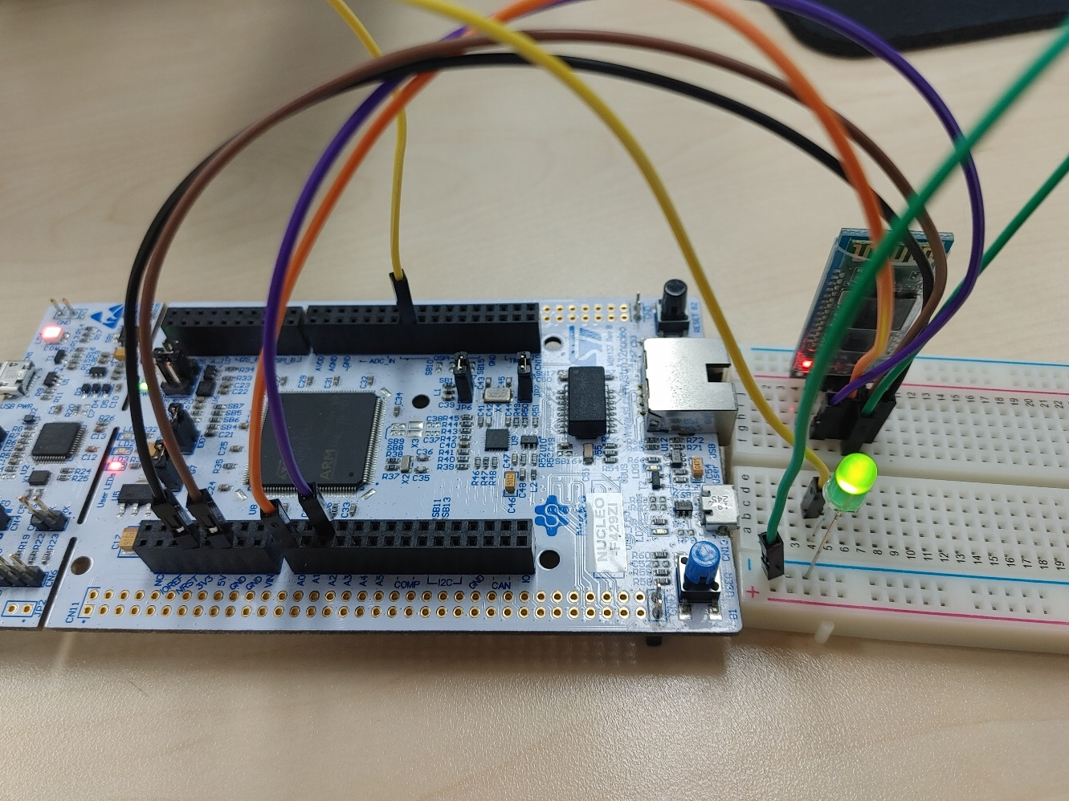
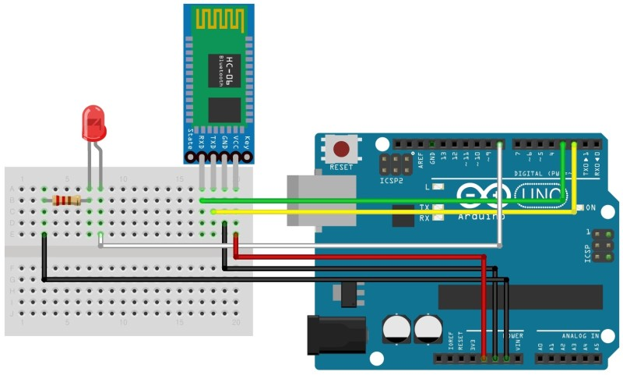
모듈배치
Notes:
GND : -
VCC : +
RX <--> TX
TX <--> RX
교차해서 연결
/* USER CODE BEGIN Header */
/**
******************************************************************************
* @file : main.c
* @brief : Main program body
******************************************************************************
* @attention
*
* Copyright (c) 2023 STMicroelectronics.
* All rights reserved.
*
* This software is licensed under terms that can be found in the LICENSE file
* in the root directory of this software component.
* If no LICENSE file comes with this software, it is provided AS-IS.
*
******************************************************************************
*/
/* USER CODE END Header */
/* Includes ------------------------------------------------------------------*/
#include "main.h"
/* Private includes ----------------------------------------------------------*/
/* USER CODE BEGIN Includes */
/* USER CODE END Includes */
/* Private typedef -----------------------------------------------------------*/
/* USER CODE BEGIN PTD */
/* USER CODE END PTD */
/* Private define ------------------------------------------------------------*/
/* USER CODE BEGIN PD */
/* USER CODE END PD */
/* Private macro -------------------------------------------------------------*/
/* USER CODE BEGIN PM */
/* USER CODE END PM */
/* Private variables ---------------------------------------------------------*/
UART_HandleTypeDef huart1;
UART_HandleTypeDef huart2;
/* USER CODE BEGIN PV */
/* USER CODE END PV */
/* Private function prototypes -----------------------------------------------*/
void SystemClock_Config(void);
static void MX_GPIO_Init(void);
static void MX_USART1_UART_Init(void);
static void MX_USART2_UART_Init(void);
/* USER CODE BEGIN PFP */
/* USER CODE END PFP */
/* Private user code ---------------------------------------------------------*/
/* USER CODE BEGIN 0 */
int _write(int file, char * p, int len){ //
HAL_UART_Transmit(&huart1 , (uint8_t *)p, len, 10);
HAL_UART_Transmit(&huart2 , (uint8_t *)p, len, 10);
return len;
}
/* USER CODE END 0 */
/**
* @brief The application entry point.
* @retval int
*/
int main(void)
{
/* USER CODE BEGIN 1 */
/* USER CODE END 1 */
/* MCU Configuration--------------------------------------------------------*/
/* Reset of all peripherals, Initializes the Flash interface and the Systick. */
HAL_Init();
/* USER CODE BEGIN Init */
/* USER CODE END Init */
/* Configure the system clock */
SystemClock_Config();
/* USER CODE BEGIN SysInit */
/* USER CODE END SysInit */
/* Initialize all configured peripherals */
MX_GPIO_Init();
MX_USART1_UART_Init();
MX_USART2_UART_Init();
/* USER CODE BEGIN 2 */
uint8_t data = 0;
uint8_t num = 0;
/* USER CODE END 2 */
/* Infinite loop */
/* USER CODE BEGIN WHILE */
printf("connected\r\n");
while (1)
{
/* USER CODE END WHILE */
/* USER CODE BEGIN 3 */
HAL_UART_Receive(&huart1, &data, 1, 10);
switch(data)
{
case '0':
HAL_GPIO_TogglePin(GPIOC, GPIO_PIN_0);
if(HAL_GPIO_ReadPin(GPIOC, GPIO_PIN_0))
{
num = num | (1 << 0);
printf("LED0 ON hex : %x\r\n", num);
}
else
{
num = num & ~(1 << 0);
printf("LED0 OFF hex : %x\r\n", num);
}
break;
case '1':
HAL_GPIO_TogglePin(GPIOC, GPIO_PIN_1);
if(HAL_GPIO_ReadPin(GPIOC, GPIO_PIN_1))
{
num = num | (1 << 1);
printf("LED1 ON hex : %x\r\n", num);
}
else
{
num = num & ~(1 << 1);
printf("LED1 OFF hex : %x\r\n", num);
}
break;
case '2':
HAL_GPIO_TogglePin(GPIOC, GPIO_PIN_2);
if(HAL_GPIO_ReadPin(GPIOC, GPIO_PIN_2))
{
num = num | (1 << 2);
printf("LED2 ON hex : %x\r\n", num);
}
else
{
num = num & ~(1 << 2);
printf("LED2 OFF hex : %x\r\n", num);
}
break;
case '3':
HAL_GPIO_TogglePin(GPIOC, GPIO_PIN_3);
if(HAL_GPIO_ReadPin(GPIOC, GPIO_PIN_3))
{
num = num | (1 << 3);
printf("LED3 ON hex : %x\r\n", num);
}
else
{
num = num & ~(1 << 3);
printf("LED3 OFF hex : %x\r\n", num);
}
break;
case '4':
HAL_GPIO_TogglePin(GPIOC, GPIO_PIN_4);
if(HAL_GPIO_ReadPin(GPIOC, GPIO_PIN_4))
{
num = num | (1 << 4);
printf("LED4 ON hex : %x\r\n", num);
}
else
{
num = num & ~(1 << 4);
printf("LED4 OFF hex : %x\r\n", num);
}
break;
case '5':
HAL_GPIO_TogglePin(GPIOC, GPIO_PIN_5);
if(HAL_GPIO_ReadPin(GPIOC, GPIO_PIN_5))
{
num = num | (1 << 5);
printf("LED5 ON hex : %x\r\n", num);
}
else
{
num = num & ~(1 << 5);
printf("LED5 OFF hex : %x\r\n", num);
}
break;
case '6':
HAL_GPIO_TogglePin(GPIOC, GPIO_PIN_6);
if(HAL_GPIO_ReadPin(GPIOC, GPIO_PIN_6))
{
num = num | (1 << 6);
printf("LED6 ON hex : %x\r\n", num);
}
else
{
num = num & ~(1 << 6);
printf("LED6 OFF hex : %x\r\n", num);
}
break;
case '7':
HAL_GPIO_TogglePin(GPIOC, GPIO_PIN_7);
if(HAL_GPIO_ReadPin(GPIOC, GPIO_PIN_7))
{
num = num | (1 << 7);
printf("LED7 ON hex : %x\r\n", num);
}
else
{
num = num & ~(1 << 7);
printf("LED7 OFF hex : %x\r\n", num);
}
break;
}
data = 0;
}
/* USER CODE END 3 */
}
/**
* @brief System Clock Configuration
* @retval None
*/
void SystemClock_Config(void)
{
RCC_OscInitTypeDef RCC_OscInitStruct = {0};
RCC_ClkInitTypeDef RCC_ClkInitStruct = {0};
/** Configure the main internal regulator output voltage
*/
__HAL_RCC_PWR_CLK_ENABLE();
__HAL_PWR_VOLTAGESCALING_CONFIG(PWR_REGULATOR_VOLTAGE_SCALE1);
/** Initializes the RCC Oscillators according to the specified parameters
* in the RCC_OscInitTypeDef structure.
*/
RCC_OscInitStruct.OscillatorType = RCC_OSCILLATORTYPE_HSI;
RCC_OscInitStruct.HSIState = RCC_HSI_ON;
RCC_OscInitStruct.HSICalibrationValue = RCC_HSICALIBRATION_DEFAULT;
RCC_OscInitStruct.PLL.PLLState = RCC_PLL_NONE;
if (HAL_RCC_OscConfig(&RCC_OscInitStruct) != HAL_OK)
{
Error_Handler();
}
/** Initializes the CPU, AHB and APB buses clocks
*/
RCC_ClkInitStruct.ClockType = RCC_CLOCKTYPE_HCLK|RCC_CLOCKTYPE_SYSCLK
|RCC_CLOCKTYPE_PCLK1|RCC_CLOCKTYPE_PCLK2;
RCC_ClkInitStruct.SYSCLKSource = RCC_SYSCLKSOURCE_HSI;
RCC_ClkInitStruct.AHBCLKDivider = RCC_SYSCLK_DIV1;
RCC_ClkInitStruct.APB1CLKDivider = RCC_HCLK_DIV1;
RCC_ClkInitStruct.APB2CLKDivider = RCC_HCLK_DIV1;
if (HAL_RCC_ClockConfig(&RCC_ClkInitStruct, FLASH_LATENCY_0) != HAL_OK)
{
Error_Handler();
}
}
/**
* @brief USART1 Initialization Function
* @param None
* @retval None
*/
static void MX_USART1_UART_Init(void)
{
/* USER CODE BEGIN USART1_Init 0 */
/* USER CODE END USART1_Init 0 */
/* USER CODE BEGIN USART1_Init 1 */
/* USER CODE END USART1_Init 1 */
huart1.Instance = USART1;
huart1.Init.BaudRate = 115200;
huart1.Init.WordLength = UART_WORDLENGTH_8B;
huart1.Init.StopBits = UART_STOPBITS_1;
huart1.Init.Parity = UART_PARITY_NONE;
huart1.Init.Mode = UART_MODE_TX_RX;
huart1.Init.HwFlowCtl = UART_HWCONTROL_NONE;
huart1.Init.OverSampling = UART_OVERSAMPLING_16;
if (HAL_UART_Init(&huart1) != HAL_OK)
{
Error_Handler();
}
/* USER CODE BEGIN USART1_Init 2 */
/* USER CODE END USART1_Init 2 */
}
/**
* @brief USART2 Initialization Function
* @param None
* @retval None
*/
static void MX_USART2_UART_Init(void)
{
/* USER CODE BEGIN USART2_Init 0 */
/* USER CODE END USART2_Init 0 */
/* USER CODE BEGIN USART2_Init 1 */
/* USER CODE END USART2_Init 1 */
huart2.Instance = USART2;
huart2.Init.BaudRate = 115200;
huart2.Init.WordLength = UART_WORDLENGTH_8B;
huart2.Init.StopBits = UART_STOPBITS_1;
huart2.Init.Parity = UART_PARITY_NONE;
huart2.Init.Mode = UART_MODE_TX_RX;
huart2.Init.HwFlowCtl = UART_HWCONTROL_NONE;
huart2.Init.OverSampling = UART_OVERSAMPLING_16;
if (HAL_UART_Init(&huart2) != HAL_OK)
{
Error_Handler();
}
/* USER CODE BEGIN USART2_Init 2 */
/* USER CODE END USART2_Init 2 */
}
/**
* @brief GPIO Initialization Function
* @param None
* @retval None
*/
static void MX_GPIO_Init(void)
{
GPIO_InitTypeDef GPIO_InitStruct = {0};
/* USER CODE BEGIN MX_GPIO_Init_1 */
/* USER CODE END MX_GPIO_Init_1 */
/* GPIO Ports Clock Enable */
__HAL_RCC_GPIOC_CLK_ENABLE();
__HAL_RCC_GPIOA_CLK_ENABLE();
/*Configure GPIO pin Output Level */
HAL_GPIO_WritePin(GPIOC, LED0_Pin|LED1_Pin|LED2_Pin|LED3_Pin
|LED4_Pin|LED5_Pin|LED6_Pin|LED7_Pin, GPIO_PIN_RESET);
/*Configure GPIO pins : LED0_Pin LED1_Pin LED2_Pin LED3_Pin
LED4_Pin LED5_Pin LED6_Pin LED7_Pin */
GPIO_InitStruct.Pin = LED0_Pin|LED1_Pin|LED2_Pin|LED3_Pin
|LED4_Pin|LED5_Pin|LED6_Pin|LED7_Pin;
GPIO_InitStruct.Mode = GPIO_MODE_OUTPUT_PP;
GPIO_InitStruct.Pull = GPIO_NOPULL;
GPIO_InitStruct.Speed = GPIO_SPEED_FREQ_LOW;
HAL_GPIO_Init(GPIOC, &GPIO_InitStruct);
/* USER CODE BEGIN MX_GPIO_Init_2 */
/* USER CODE END MX_GPIO_Init_2 */
}
/* USER CODE BEGIN 4 */
/* USER CODE END 4 */
/**
* @brief This function is executed in case of error occurrence.
* @retval None
*/
void Error_Handler(void)
{
/* USER CODE BEGIN Error_Handler_Debug */
/* User can add his own implementation to report the HAL error return state */
__disable_irq();
while (1)
{
}
/* USER CODE END Error_Handler_Debug */
}
#ifdef USE_FULL_ASSERT
/**
* @brief Reports the name of the source file and the source line number
* where the assert_param error has occurred.
* @param file: pointer to the source file name
* @param line: assert_param error line source number
* @retval None
*/
void assert_failed(uint8_t *file, uint32_t line)
{
/* USER CODE BEGIN 6 */
/* User can add his own implementation to report the file name and line number,
ex: printf("Wrong parameters value: file %s on line %d\r\n", file, line) */
/* USER CODE END 6 */
}
#endif /* USE_FULL_ASSERT */

Slide 20
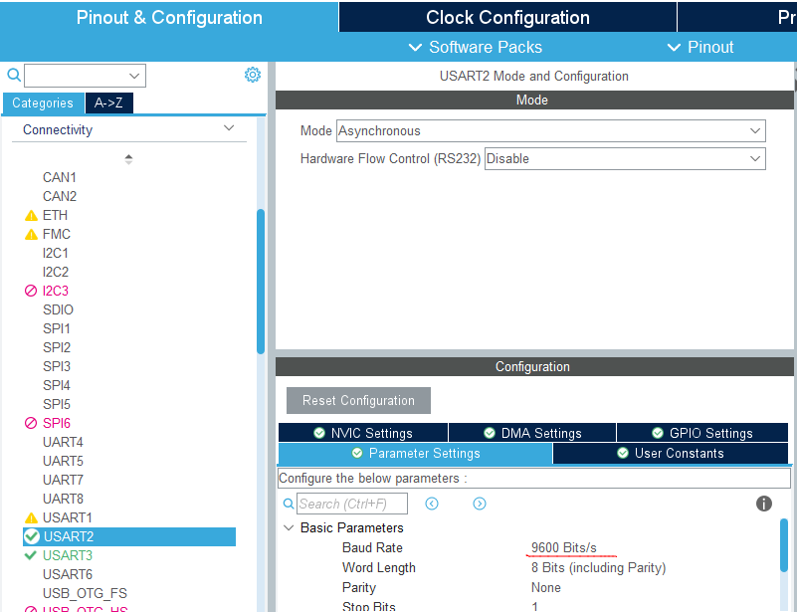
USART2 설정 (STM32 – HC-06)
USART2 - PA3, PD5
Notes:
/* USER CODE BEGIN Header */
/**
******************************************************************************
* @file : main.c
* @brief : Main program body
******************************************************************************
* @attention
*
* Copyright (c) 2023 STMicroelectronics.
* All rights reserved.
*
* This software is licensed under terms that can be found in the LICENSE file
* in the root directory of this software component.
* If no LICENSE file comes with this software, it is provided AS-IS.
*
******************************************************************************
*/
/* USER CODE END Header */
/* Includes ------------------------------------------------------------------*/
#include "main.h"
/* Private includes ----------------------------------------------------------*/
/* USER CODE BEGIN Includes */
/* USER CODE END Includes */
/* Private typedef -----------------------------------------------------------*/
/* USER CODE BEGIN PTD */
/* USER CODE END PTD */
/* Private define ------------------------------------------------------------*/
/* USER CODE BEGIN PD */
/* USER CODE END PD */
/* Private macro -------------------------------------------------------------*/
/* USER CODE BEGIN PM */
/* USER CODE END PM */
/* Private variables ---------------------------------------------------------*/
UART_HandleTypeDef huart1;
UART_HandleTypeDef huart2;
/* USER CODE BEGIN PV */
/* USER CODE END PV */
/* Private function prototypes -----------------------------------------------*/
void SystemClock_Config(void);
static void MX_GPIO_Init(void);
static void MX_USART1_UART_Init(void);
static void MX_USART2_UART_Init(void);
/* USER CODE BEGIN PFP */
/* USER CODE END PFP */
/* Private user code ---------------------------------------------------------*/
/* USER CODE BEGIN 0 */
int _write(int file, char * p, int len){ //
HAL_UART_Transmit(&huart1 , (uint8_t *)p, len, 10);
HAL_UART_Transmit(&huart2 , (uint8_t *)p, len, 10);
return len;
}
/* USER CODE END 0 */
/**
* @brief The application entry point.
* @retval int
*/
int main(void)
{
/* USER CODE BEGIN 1 */
/* USER CODE END 1 */
/* MCU Configuration--------------------------------------------------------*/
/* Reset of all peripherals, Initializes the Flash interface and the Systick. */
HAL_Init();
/* USER CODE BEGIN Init */
/* USER CODE END Init */
/* Configure the system clock */
SystemClock_Config();
/* USER CODE BEGIN SysInit */
/* USER CODE END SysInit */
/* Initialize all configured peripherals */
MX_GPIO_Init();
MX_USART1_UART_Init();
MX_USART2_UART_Init();
/* USER CODE BEGIN 2 */
uint8_t data = 0;
uint8_t num = 0;
/* USER CODE END 2 */
/* Infinite loop */
/* USER CODE BEGIN WHILE */
printf("connected\r\n");
while (1)
{
/* USER CODE END WHILE */
/* USER CODE BEGIN 3 */
HAL_UART_Receive(&huart1, &data, 1, 10);
switch(data)
{
case '0':
HAL_GPIO_TogglePin(GPIOC, GPIO_PIN_0);
if(HAL_GPIO_ReadPin(GPIOC, GPIO_PIN_0))
{
num = num | (1 << 0);
printf("LED0 ON hex : %x\r\n", num);
}
else
{
num = num & ~(1 << 0);
printf("LED0 OFF hex : %x\r\n", num);
}
break;
case '1':
HAL_GPIO_TogglePin(GPIOC, GPIO_PIN_1);
if(HAL_GPIO_ReadPin(GPIOC, GPIO_PIN_1))
{
num = num | (1 << 1);
printf("LED1 ON hex : %x\r\n", num);
}
else
{
num = num & ~(1 << 1);
printf("LED1 OFF hex : %x\r\n", num);
}
break;
case '2':
HAL_GPIO_TogglePin(GPIOC, GPIO_PIN_2);
if(HAL_GPIO_ReadPin(GPIOC, GPIO_PIN_2))
{
num = num | (1 << 2);
printf("LED2 ON hex : %x\r\n", num);
}
else
{
num = num & ~(1 << 2);
printf("LED2 OFF hex : %x\r\n", num);
}
break;
case '3':
HAL_GPIO_TogglePin(GPIOC, GPIO_PIN_3);
if(HAL_GPIO_ReadPin(GPIOC, GPIO_PIN_3))
{
num = num | (1 << 3);
printf("LED3 ON hex : %x\r\n", num);
}
else
{
num = num & ~(1 << 3);
printf("LED3 OFF hex : %x\r\n", num);
}
break;
case '4':
HAL_GPIO_TogglePin(GPIOC, GPIO_PIN_4);
if(HAL_GPIO_ReadPin(GPIOC, GPIO_PIN_4))
{
num = num | (1 << 4);
printf("LED4 ON hex : %x\r\n", num);
}
else
{
num = num & ~(1 << 4);
printf("LED4 OFF hex : %x\r\n", num);
}
break;
case '5':
HAL_GPIO_TogglePin(GPIOC, GPIO_PIN_5);
if(HAL_GPIO_ReadPin(GPIOC, GPIO_PIN_5))
{
num = num | (1 << 5);
printf("LED5 ON hex : %x\r\n", num);
}
else
{
num = num & ~(1 << 5);
printf("LED5 OFF hex : %x\r\n", num);
}
break;
case '6':
HAL_GPIO_TogglePin(GPIOC, GPIO_PIN_6);
if(HAL_GPIO_ReadPin(GPIOC, GPIO_PIN_6))
{
num = num | (1 << 6);
printf("LED6 ON hex : %x\r\n", num);
}
else
{
num = num & ~(1 << 6);
printf("LED6 OFF hex : %x\r\n", num);
}
break;
case '7':
HAL_GPIO_TogglePin(GPIOC, GPIO_PIN_7);
if(HAL_GPIO_ReadPin(GPIOC, GPIO_PIN_7))
{
num = num | (1 << 7);
printf("LED7 ON hex : %x\r\n", num);
}
else
{
num = num & ~(1 << 7);
printf("LED7 OFF hex : %x\r\n", num);
}
break;
}
data = 0;
}
/* USER CODE END 3 */
}
/**
* @brief System Clock Configuration
* @retval None
*/
void SystemClock_Config(void)
{
RCC_OscInitTypeDef RCC_OscInitStruct = {0};
RCC_ClkInitTypeDef RCC_ClkInitStruct = {0};
/** Configure the main internal regulator output voltage
*/
__HAL_RCC_PWR_CLK_ENABLE();
__HAL_PWR_VOLTAGESCALING_CONFIG(PWR_REGULATOR_VOLTAGE_SCALE1);
/** Initializes the RCC Oscillators according to the specified parameters
* in the RCC_OscInitTypeDef structure.
*/
RCC_OscInitStruct.OscillatorType = RCC_OSCILLATORTYPE_HSI;
RCC_OscInitStruct.HSIState = RCC_HSI_ON;
RCC_OscInitStruct.HSICalibrationValue = RCC_HSICALIBRATION_DEFAULT;
RCC_OscInitStruct.PLL.PLLState = RCC_PLL_NONE;
if (HAL_RCC_OscConfig(&RCC_OscInitStruct) != HAL_OK)
{
Error_Handler();
}
/** Initializes the CPU, AHB and APB buses clocks
*/
RCC_ClkInitStruct.ClockType = RCC_CLOCKTYPE_HCLK|RCC_CLOCKTYPE_SYSCLK
|RCC_CLOCKTYPE_PCLK1|RCC_CLOCKTYPE_PCLK2;
RCC_ClkInitStruct.SYSCLKSource = RCC_SYSCLKSOURCE_HSI;
RCC_ClkInitStruct.AHBCLKDivider = RCC_SYSCLK_DIV1;
RCC_ClkInitStruct.APB1CLKDivider = RCC_HCLK_DIV1;
RCC_ClkInitStruct.APB2CLKDivider = RCC_HCLK_DIV1;
if (HAL_RCC_ClockConfig(&RCC_ClkInitStruct, FLASH_LATENCY_0) != HAL_OK)
{
Error_Handler();
}
}
/**
* @brief USART1 Initialization Function
* @param None
* @retval None
*/
static void MX_USART1_UART_Init(void)
{
/* USER CODE BEGIN USART1_Init 0 */
/* USER CODE END USART1_Init 0 */
/* USER CODE BEGIN USART1_Init 1 */
/* USER CODE END USART1_Init 1 */
huart1.Instance = USART1;
huart1.Init.BaudRate = 115200;
huart1.Init.WordLength = UART_WORDLENGTH_8B;
huart1.Init.StopBits = UART_STOPBITS_1;
huart1.Init.Parity = UART_PARITY_NONE;
huart1.Init.Mode = UART_MODE_TX_RX;
huart1.Init.HwFlowCtl = UART_HWCONTROL_NONE;
huart1.Init.OverSampling = UART_OVERSAMPLING_16;
if (HAL_UART_Init(&huart1) != HAL_OK)
{
Error_Handler();
}
/* USER CODE BEGIN USART1_Init 2 */
/* USER CODE END USART1_Init 2 */
}
/**
* @brief USART2 Initialization Function
* @param None
* @retval None
*/
static void MX_USART2_UART_Init(void)
{
/* USER CODE BEGIN USART2_Init 0 */
/* USER CODE END USART2_Init 0 */
/* USER CODE BEGIN USART2_Init 1 */
/* USER CODE END USART2_Init 1 */
huart2.Instance = USART2;
huart2.Init.BaudRate = 115200;
huart2.Init.WordLength = UART_WORDLENGTH_8B;
huart2.Init.StopBits = UART_STOPBITS_1;
huart2.Init.Parity = UART_PARITY_NONE;
huart2.Init.Mode = UART_MODE_TX_RX;
huart2.Init.HwFlowCtl = UART_HWCONTROL_NONE;
huart2.Init.OverSampling = UART_OVERSAMPLING_16;
if (HAL_UART_Init(&huart2) != HAL_OK)
{
Error_Handler();
}
/* USER CODE BEGIN USART2_Init 2 */
/* USER CODE END USART2_Init 2 */
}
/**
* @brief GPIO Initialization Function
* @param None
* @retval None
*/
static void MX_GPIO_Init(void)
{
GPIO_InitTypeDef GPIO_InitStruct = {0};
/* USER CODE BEGIN MX_GPIO_Init_1 */
/* USER CODE END MX_GPIO_Init_1 */
/* GPIO Ports Clock Enable */
__HAL_RCC_GPIOC_CLK_ENABLE();
__HAL_RCC_GPIOA_CLK_ENABLE();
/*Configure GPIO pin Output Level */
HAL_GPIO_WritePin(GPIOC, LED0_Pin|LED1_Pin|LED2_Pin|LED3_Pin
|LED4_Pin|LED5_Pin|LED6_Pin|LED7_Pin, GPIO_PIN_RESET);
/*Configure GPIO pins : LED0_Pin LED1_Pin LED2_Pin LED3_Pin
LED4_Pin LED5_Pin LED6_Pin LED7_Pin */
GPIO_InitStruct.Pin = LED0_Pin|LED1_Pin|LED2_Pin|LED3_Pin
|LED4_Pin|LED5_Pin|LED6_Pin|LED7_Pin;
GPIO_InitStruct.Mode = GPIO_MODE_OUTPUT_PP;
GPIO_InitStruct.Pull = GPIO_NOPULL;
GPIO_InitStruct.Speed = GPIO_SPEED_FREQ_LOW;
HAL_GPIO_Init(GPIOC, &GPIO_InitStruct);
/* USER CODE BEGIN MX_GPIO_Init_2 */
/* USER CODE END MX_GPIO_Init_2 */
}
/* USER CODE BEGIN 4 */
/* USER CODE END 4 */
/**
* @brief This function is executed in case of error occurrence.
* @retval None
*/
void Error_Handler(void)
{
/* USER CODE BEGIN Error_Handler_Debug */
/* User can add his own implementation to report the HAL error return state */
__disable_irq();
while (1)
{
}
/* USER CODE END Error_Handler_Debug */
}
#ifdef USE_FULL_ASSERT
/**
* @brief Reports the name of the source file and the source line number
* where the assert_param error has occurred.
* @param file: pointer to the source file name
* @param line: assert_param error line source number
* @retval None
*/
void assert_failed(uint8_t *file, uint32_t line)
{
/* USER CODE BEGIN 6 */
/* User can add his own implementation to report the file name and line number,
ex: printf("Wrong parameters value: file %s on line %d\r\n", file, line) */
/* USER CODE END 6 */
}
#endif /* USE_FULL_ASSERT */

Slide 21
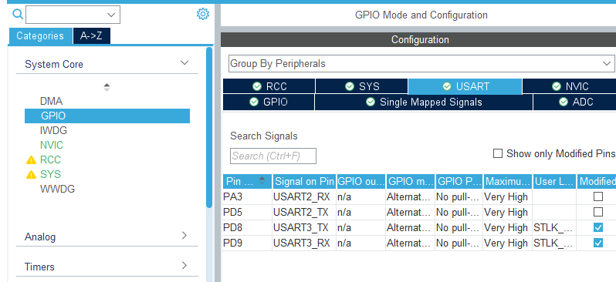
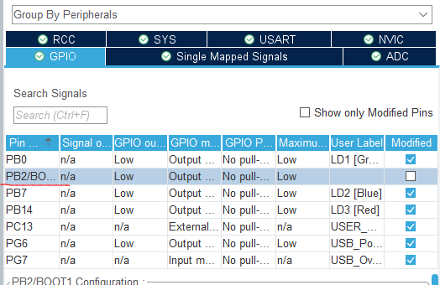
GPIO 정보
Notes:
/* USER CODE BEGIN Header */
/**
******************************************************************************
* @file : main.c
* @brief : Main program body
******************************************************************************
* @attention
*
* Copyright (c) 2023 STMicroelectronics.
* All rights reserved.
*
* This software is licensed under terms that can be found in the LICENSE file
* in the root directory of this software component.
* If no LICENSE file comes with this software, it is provided AS-IS.
*
******************************************************************************
*/
/* USER CODE END Header */
/* Includes ------------------------------------------------------------------*/
#include "main.h"
/* Private includes ----------------------------------------------------------*/
/* USER CODE BEGIN Includes */
/* USER CODE END Includes */
/* Private typedef -----------------------------------------------------------*/
/* USER CODE BEGIN PTD */
/* USER CODE END PTD */
/* Private define ------------------------------------------------------------*/
/* USER CODE BEGIN PD */
/* USER CODE END PD */
/* Private macro -------------------------------------------------------------*/
/* USER CODE BEGIN PM */
/* USER CODE END PM */
/* Private variables ---------------------------------------------------------*/
UART_HandleTypeDef huart1;
UART_HandleTypeDef huart2;
/* USER CODE BEGIN PV */
/* USER CODE END PV */
/* Private function prototypes -----------------------------------------------*/
void SystemClock_Config(void);
static void MX_GPIO_Init(void);
static void MX_USART1_UART_Init(void);
static void MX_USART2_UART_Init(void);
/* USER CODE BEGIN PFP */
/* USER CODE END PFP */
/* Private user code ---------------------------------------------------------*/
/* USER CODE BEGIN 0 */
int _write(int file, char * p, int len){ //
HAL_UART_Transmit(&huart1 , (uint8_t *)p, len, 10);
HAL_UART_Transmit(&huart2 , (uint8_t *)p, len, 10);
return len;
}
/* USER CODE END 0 */
/**
* @brief The application entry point.
* @retval int
*/
int main(void)
{
/* USER CODE BEGIN 1 */
/* USER CODE END 1 */
/* MCU Configuration--------------------------------------------------------*/
/* Reset of all peripherals, Initializes the Flash interface and the Systick. */
HAL_Init();
/* USER CODE BEGIN Init */
/* USER CODE END Init */
/* Configure the system clock */
SystemClock_Config();
/* USER CODE BEGIN SysInit */
/* USER CODE END SysInit */
/* Initialize all configured peripherals */
MX_GPIO_Init();
MX_USART1_UART_Init();
MX_USART2_UART_Init();
/* USER CODE BEGIN 2 */
uint8_t data = 0;
uint8_t num = 0;
/* USER CODE END 2 */
/* Infinite loop */
/* USER CODE BEGIN WHILE */
printf("connected\r\n");
while (1)
{
/* USER CODE END WHILE */
/* USER CODE BEGIN 3 */
HAL_UART_Receive(&huart1, &data, 1, 10);
switch(data)
{
case '0':
HAL_GPIO_TogglePin(GPIOC, GPIO_PIN_0);
if(HAL_GPIO_ReadPin(GPIOC, GPIO_PIN_0))
{
num = num | (1 << 0);
printf("LED0 ON hex : %x\r\n", num);
}
else
{
num = num & ~(1 << 0);
printf("LED0 OFF hex : %x\r\n", num);
}
break;
case '1':
HAL_GPIO_TogglePin(GPIOC, GPIO_PIN_1);
if(HAL_GPIO_ReadPin(GPIOC, GPIO_PIN_1))
{
num = num | (1 << 1);
printf("LED1 ON hex : %x\r\n", num);
}
else
{
num = num & ~(1 << 1);
printf("LED1 OFF hex : %x\r\n", num);
}
break;
case '2':
HAL_GPIO_TogglePin(GPIOC, GPIO_PIN_2);
if(HAL_GPIO_ReadPin(GPIOC, GPIO_PIN_2))
{
num = num | (1 << 2);
printf("LED2 ON hex : %x\r\n", num);
}
else
{
num = num & ~(1 << 2);
printf("LED2 OFF hex : %x\r\n", num);
}
break;
case '3':
HAL_GPIO_TogglePin(GPIOC, GPIO_PIN_3);
if(HAL_GPIO_ReadPin(GPIOC, GPIO_PIN_3))
{
num = num | (1 << 3);
printf("LED3 ON hex : %x\r\n", num);
}
else
{
num = num & ~(1 << 3);
printf("LED3 OFF hex : %x\r\n", num);
}
break;
case '4':
HAL_GPIO_TogglePin(GPIOC, GPIO_PIN_4);
if(HAL_GPIO_ReadPin(GPIOC, GPIO_PIN_4))
{
num = num | (1 << 4);
printf("LED4 ON hex : %x\r\n", num);
}
else
{
num = num & ~(1 << 4);
printf("LED4 OFF hex : %x\r\n", num);
}
break;
case '5':
HAL_GPIO_TogglePin(GPIOC, GPIO_PIN_5);
if(HAL_GPIO_ReadPin(GPIOC, GPIO_PIN_5))
{
num = num | (1 << 5);
printf("LED5 ON hex : %x\r\n", num);
}
else
{
num = num & ~(1 << 5);
printf("LED5 OFF hex : %x\r\n", num);
}
break;
case '6':
HAL_GPIO_TogglePin(GPIOC, GPIO_PIN_6);
if(HAL_GPIO_ReadPin(GPIOC, GPIO_PIN_6))
{
num = num | (1 << 6);
printf("LED6 ON hex : %x\r\n", num);
}
else
{
num = num & ~(1 << 6);
printf("LED6 OFF hex : %x\r\n", num);
}
break;
case '7':
HAL_GPIO_TogglePin(GPIOC, GPIO_PIN_7);
if(HAL_GPIO_ReadPin(GPIOC, GPIO_PIN_7))
{
num = num | (1 << 7);
printf("LED7 ON hex : %x\r\n", num);
}
else
{
num = num & ~(1 << 7);
printf("LED7 OFF hex : %x\r\n", num);
}
break;
}
data = 0;
}
/* USER CODE END 3 */
}
/**
* @brief System Clock Configuration
* @retval None
*/
void SystemClock_Config(void)
{
RCC_OscInitTypeDef RCC_OscInitStruct = {0};
RCC_ClkInitTypeDef RCC_ClkInitStruct = {0};
/** Configure the main internal regulator output voltage
*/
__HAL_RCC_PWR_CLK_ENABLE();
__HAL_PWR_VOLTAGESCALING_CONFIG(PWR_REGULATOR_VOLTAGE_SCALE1);
/** Initializes the RCC Oscillators according to the specified parameters
* in the RCC_OscInitTypeDef structure.
*/
RCC_OscInitStruct.OscillatorType = RCC_OSCILLATORTYPE_HSI;
RCC_OscInitStruct.HSIState = RCC_HSI_ON;
RCC_OscInitStruct.HSICalibrationValue = RCC_HSICALIBRATION_DEFAULT;
RCC_OscInitStruct.PLL.PLLState = RCC_PLL_NONE;
if (HAL_RCC_OscConfig(&RCC_OscInitStruct) != HAL_OK)
{
Error_Handler();
}
/** Initializes the CPU, AHB and APB buses clocks
*/
RCC_ClkInitStruct.ClockType = RCC_CLOCKTYPE_HCLK|RCC_CLOCKTYPE_SYSCLK
|RCC_CLOCKTYPE_PCLK1|RCC_CLOCKTYPE_PCLK2;
RCC_ClkInitStruct.SYSCLKSource = RCC_SYSCLKSOURCE_HSI;
RCC_ClkInitStruct.AHBCLKDivider = RCC_SYSCLK_DIV1;
RCC_ClkInitStruct.APB1CLKDivider = RCC_HCLK_DIV1;
RCC_ClkInitStruct.APB2CLKDivider = RCC_HCLK_DIV1;
if (HAL_RCC_ClockConfig(&RCC_ClkInitStruct, FLASH_LATENCY_0) != HAL_OK)
{
Error_Handler();
}
}
/**
* @brief USART1 Initialization Function
* @param None
* @retval None
*/
static void MX_USART1_UART_Init(void)
{
/* USER CODE BEGIN USART1_Init 0 */
/* USER CODE END USART1_Init 0 */
/* USER CODE BEGIN USART1_Init 1 */
/* USER CODE END USART1_Init 1 */
huart1.Instance = USART1;
huart1.Init.BaudRate = 115200;
huart1.Init.WordLength = UART_WORDLENGTH_8B;
huart1.Init.StopBits = UART_STOPBITS_1;
huart1.Init.Parity = UART_PARITY_NONE;
huart1.Init.Mode = UART_MODE_TX_RX;
huart1.Init.HwFlowCtl = UART_HWCONTROL_NONE;
huart1.Init.OverSampling = UART_OVERSAMPLING_16;
if (HAL_UART_Init(&huart1) != HAL_OK)
{
Error_Handler();
}
/* USER CODE BEGIN USART1_Init 2 */
/* USER CODE END USART1_Init 2 */
}
/**
* @brief USART2 Initialization Function
* @param None
* @retval None
*/
static void MX_USART2_UART_Init(void)
{
/* USER CODE BEGIN USART2_Init 0 */
/* USER CODE END USART2_Init 0 */
/* USER CODE BEGIN USART2_Init 1 */
/* USER CODE END USART2_Init 1 */
huart2.Instance = USART2;
huart2.Init.BaudRate = 115200;
huart2.Init.WordLength = UART_WORDLENGTH_8B;
huart2.Init.StopBits = UART_STOPBITS_1;
huart2.Init.Parity = UART_PARITY_NONE;
huart2.Init.Mode = UART_MODE_TX_RX;
huart2.Init.HwFlowCtl = UART_HWCONTROL_NONE;
huart2.Init.OverSampling = UART_OVERSAMPLING_16;
if (HAL_UART_Init(&huart2) != HAL_OK)
{
Error_Handler();
}
/* USER CODE BEGIN USART2_Init 2 */
/* USER CODE END USART2_Init 2 */
}
/**
* @brief GPIO Initialization Function
* @param None
* @retval None
*/
static void MX_GPIO_Init(void)
{
GPIO_InitTypeDef GPIO_InitStruct = {0};
/* USER CODE BEGIN MX_GPIO_Init_1 */
/* USER CODE END MX_GPIO_Init_1 */
/* GPIO Ports Clock Enable */
__HAL_RCC_GPIOC_CLK_ENABLE();
__HAL_RCC_GPIOA_CLK_ENABLE();
/*Configure GPIO pin Output Level */
HAL_GPIO_WritePin(GPIOC, LED0_Pin|LED1_Pin|LED2_Pin|LED3_Pin
|LED4_Pin|LED5_Pin|LED6_Pin|LED7_Pin, GPIO_PIN_RESET);
/*Configure GPIO pins : LED0_Pin LED1_Pin LED2_Pin LED3_Pin
LED4_Pin LED5_Pin LED6_Pin LED7_Pin */
GPIO_InitStruct.Pin = LED0_Pin|LED1_Pin|LED2_Pin|LED3_Pin
|LED4_Pin|LED5_Pin|LED6_Pin|LED7_Pin;
GPIO_InitStruct.Mode = GPIO_MODE_OUTPUT_PP;
GPIO_InitStruct.Pull = GPIO_NOPULL;
GPIO_InitStruct.Speed = GPIO_SPEED_FREQ_LOW;
HAL_GPIO_Init(GPIOC, &GPIO_InitStruct);
/* USER CODE BEGIN MX_GPIO_Init_2 */
/* USER CODE END MX_GPIO_Init_2 */
}
/* USER CODE BEGIN 4 */
/* USER CODE END 4 */
/**
* @brief This function is executed in case of error occurrence.
* @retval None
*/
void Error_Handler(void)
{
/* USER CODE BEGIN Error_Handler_Debug */
/* User can add his own implementation to report the HAL error return state */
__disable_irq();
while (1)
{
}
/* USER CODE END Error_Handler_Debug */
}
#ifdef USE_FULL_ASSERT
/**
* @brief Reports the name of the source file and the source line number
* where the assert_param error has occurred.
* @param file: pointer to the source file name
* @param line: assert_param error line source number
* @retval None
*/
void assert_failed(uint8_t *file, uint32_t line)
{
/* USER CODE BEGIN 6 */
/* User can add his own implementation to report the file name and line number,
ex: printf("Wrong parameters value: file %s on line %d\r\n", file, line) */
/* USER CODE END 6 */
}
#endif /* USE_FULL_ASSERT */

Slide 22
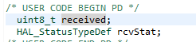
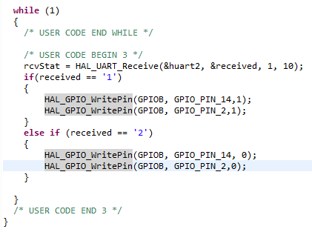
main.c
Notes:
/* USER CODE BEGIN Header */
/**
******************************************************************************
* @file : main.c
* @brief : Main program body
******************************************************************************
* @attention
*
* Copyright (c) 2023 STMicroelectronics.
* All rights reserved.
*
* This software is licensed under terms that can be found in the LICENSE file
* in the root directory of this software component.
* If no LICENSE file comes with this software, it is provided AS-IS.
*
******************************************************************************
*/
/* USER CODE END Header */
/* Includes ------------------------------------------------------------------*/
#include "main.h"
/* Private includes ----------------------------------------------------------*/
/* USER CODE BEGIN Includes */
/* USER CODE END Includes */
/* Private typedef -----------------------------------------------------------*/
/* USER CODE BEGIN PTD */
/* USER CODE END PTD */
/* Private define ------------------------------------------------------------*/
/* USER CODE BEGIN PD */
/* USER CODE END PD */
/* Private macro -------------------------------------------------------------*/
/* USER CODE BEGIN PM */
/* USER CODE END PM */
/* Private variables ---------------------------------------------------------*/
UART_HandleTypeDef huart1;
UART_HandleTypeDef huart2;
/* USER CODE BEGIN PV */
/* USER CODE END PV */
/* Private function prototypes -----------------------------------------------*/
void SystemClock_Config(void);
static void MX_GPIO_Init(void);
static void MX_USART1_UART_Init(void);
static void MX_USART2_UART_Init(void);
/* USER CODE BEGIN PFP */
/* USER CODE END PFP */
/* Private user code ---------------------------------------------------------*/
/* USER CODE BEGIN 0 */
int _write(int file, char * p, int len){ //
HAL_UART_Transmit(&huart1 , (uint8_t *)p, len, 10);
HAL_UART_Transmit(&huart2 , (uint8_t *)p, len, 10);
return len;
}
/* USER CODE END 0 */
/**
* @brief The application entry point.
* @retval int
*/
int main(void)
{
/* USER CODE BEGIN 1 */
/* USER CODE END 1 */
/* MCU Configuration--------------------------------------------------------*/
/* Reset of all peripherals, Initializes the Flash interface and the Systick. */
HAL_Init();
/* USER CODE BEGIN Init */
/* USER CODE END Init */
/* Configure the system clock */
SystemClock_Config();
/* USER CODE BEGIN SysInit */
/* USER CODE END SysInit */
/* Initialize all configured peripherals */
MX_GPIO_Init();
MX_USART1_UART_Init();
MX_USART2_UART_Init();
/* USER CODE BEGIN 2 */
uint8_t data = 0;
uint8_t num = 0;
/* USER CODE END 2 */
/* Infinite loop */
/* USER CODE BEGIN WHILE */
printf("connected\r\n");
while (1)
{
/* USER CODE END WHILE */
/* USER CODE BEGIN 3 */
HAL_UART_Receive(&huart1, &data, 1, 10);
switch(data)
{
case '0':
HAL_GPIO_TogglePin(GPIOC, GPIO_PIN_0);
if(HAL_GPIO_ReadPin(GPIOC, GPIO_PIN_0))
{
num = num | (1 << 0);
printf("LED0 ON hex : %x\r\n", num);
}
else
{
num = num & ~(1 << 0);
printf("LED0 OFF hex : %x\r\n", num);
}
break;
case '1':
HAL_GPIO_TogglePin(GPIOC, GPIO_PIN_1);
if(HAL_GPIO_ReadPin(GPIOC, GPIO_PIN_1))
{
num = num | (1 << 1);
printf("LED1 ON hex : %x\r\n", num);
}
else
{
num = num & ~(1 << 1);
printf("LED1 OFF hex : %x\r\n", num);
}
break;
case '2':
HAL_GPIO_TogglePin(GPIOC, GPIO_PIN_2);
if(HAL_GPIO_ReadPin(GPIOC, GPIO_PIN_2))
{
num = num | (1 << 2);
printf("LED2 ON hex : %x\r\n", num);
}
else
{
num = num & ~(1 << 2);
printf("LED2 OFF hex : %x\r\n", num);
}
break;
case '3':
HAL_GPIO_TogglePin(GPIOC, GPIO_PIN_3);
if(HAL_GPIO_ReadPin(GPIOC, GPIO_PIN_3))
{
num = num | (1 << 3);
printf("LED3 ON hex : %x\r\n", num);
}
else
{
num = num & ~(1 << 3);
printf("LED3 OFF hex : %x\r\n", num);
}
break;
case '4':
HAL_GPIO_TogglePin(GPIOC, GPIO_PIN_4);
if(HAL_GPIO_ReadPin(GPIOC, GPIO_PIN_4))
{
num = num | (1 << 4);
printf("LED4 ON hex : %x\r\n", num);
}
else
{
num = num & ~(1 << 4);
printf("LED4 OFF hex : %x\r\n", num);
}
break;
case '5':
HAL_GPIO_TogglePin(GPIOC, GPIO_PIN_5);
if(HAL_GPIO_ReadPin(GPIOC, GPIO_PIN_5))
{
num = num | (1 << 5);
printf("LED5 ON hex : %x\r\n", num);
}
else
{
num = num & ~(1 << 5);
printf("LED5 OFF hex : %x\r\n", num);
}
break;
case '6':
HAL_GPIO_TogglePin(GPIOC, GPIO_PIN_6);
if(HAL_GPIO_ReadPin(GPIOC, GPIO_PIN_6))
{
num = num | (1 << 6);
printf("LED6 ON hex : %x\r\n", num);
}
else
{
num = num & ~(1 << 6);
printf("LED6 OFF hex : %x\r\n", num);
}
break;
case '7':
HAL_GPIO_TogglePin(GPIOC, GPIO_PIN_7);
if(HAL_GPIO_ReadPin(GPIOC, GPIO_PIN_7))
{
num = num | (1 << 7);
printf("LED7 ON hex : %x\r\n", num);
}
else
{
num = num & ~(1 << 7);
printf("LED7 OFF hex : %x\r\n", num);
}
break;
}
data = 0;
}
/* USER CODE END 3 */
}
/**
* @brief System Clock Configuration
* @retval None
*/
void SystemClock_Config(void)
{
RCC_OscInitTypeDef RCC_OscInitStruct = {0};
RCC_ClkInitTypeDef RCC_ClkInitStruct = {0};
/** Configure the main internal regulator output voltage
*/
__HAL_RCC_PWR_CLK_ENABLE();
__HAL_PWR_VOLTAGESCALING_CONFIG(PWR_REGULATOR_VOLTAGE_SCALE1);
/** Initializes the RCC Oscillators according to the specified parameters
* in the RCC_OscInitTypeDef structure.
*/
RCC_OscInitStruct.OscillatorType = RCC_OSCILLATORTYPE_HSI;
RCC_OscInitStruct.HSIState = RCC_HSI_ON;
RCC_OscInitStruct.HSICalibrationValue = RCC_HSICALIBRATION_DEFAULT;
RCC_OscInitStruct.PLL.PLLState = RCC_PLL_NONE;
if (HAL_RCC_OscConfig(&RCC_OscInitStruct) != HAL_OK)
{
Error_Handler();
}
/** Initializes the CPU, AHB and APB buses clocks
*/
RCC_ClkInitStruct.ClockType = RCC_CLOCKTYPE_HCLK|RCC_CLOCKTYPE_SYSCLK
|RCC_CLOCKTYPE_PCLK1|RCC_CLOCKTYPE_PCLK2;
RCC_ClkInitStruct.SYSCLKSource = RCC_SYSCLKSOURCE_HSI;
RCC_ClkInitStruct.AHBCLKDivider = RCC_SYSCLK_DIV1;
RCC_ClkInitStruct.APB1CLKDivider = RCC_HCLK_DIV1;
RCC_ClkInitStruct.APB2CLKDivider = RCC_HCLK_DIV1;
if (HAL_RCC_ClockConfig(&RCC_ClkInitStruct, FLASH_LATENCY_0) != HAL_OK)
{
Error_Handler();
}
}
/**
* @brief USART1 Initialization Function
* @param None
* @retval None
*/
static void MX_USART1_UART_Init(void)
{
/* USER CODE BEGIN USART1_Init 0 */
/* USER CODE END USART1_Init 0 */
/* USER CODE BEGIN USART1_Init 1 */
/* USER CODE END USART1_Init 1 */
huart1.Instance = USART1;
huart1.Init.BaudRate = 115200;
huart1.Init.WordLength = UART_WORDLENGTH_8B;
huart1.Init.StopBits = UART_STOPBITS_1;
huart1.Init.Parity = UART_PARITY_NONE;
huart1.Init.Mode = UART_MODE_TX_RX;
huart1.Init.HwFlowCtl = UART_HWCONTROL_NONE;
huart1.Init.OverSampling = UART_OVERSAMPLING_16;
if (HAL_UART_Init(&huart1) != HAL_OK)
{
Error_Handler();
}
/* USER CODE BEGIN USART1_Init 2 */
/* USER CODE END USART1_Init 2 */
}
/**
* @brief USART2 Initialization Function
* @param None
* @retval None
*/
static void MX_USART2_UART_Init(void)
{
/* USER CODE BEGIN USART2_Init 0 */
/* USER CODE END USART2_Init 0 */
/* USER CODE BEGIN USART2_Init 1 */
/* USER CODE END USART2_Init 1 */
huart2.Instance = USART2;
huart2.Init.BaudRate = 115200;
huart2.Init.WordLength = UART_WORDLENGTH_8B;
huart2.Init.StopBits = UART_STOPBITS_1;
huart2.Init.Parity = UART_PARITY_NONE;
huart2.Init.Mode = UART_MODE_TX_RX;
huart2.Init.HwFlowCtl = UART_HWCONTROL_NONE;
huart2.Init.OverSampling = UART_OVERSAMPLING_16;
if (HAL_UART_Init(&huart2) != HAL_OK)
{
Error_Handler();
}
/* USER CODE BEGIN USART2_Init 2 */
/* USER CODE END USART2_Init 2 */
}
/**
* @brief GPIO Initialization Function
* @param None
* @retval None
*/
static void MX_GPIO_Init(void)
{
GPIO_InitTypeDef GPIO_InitStruct = {0};
/* USER CODE BEGIN MX_GPIO_Init_1 */
/* USER CODE END MX_GPIO_Init_1 */
/* GPIO Ports Clock Enable */
__HAL_RCC_GPIOC_CLK_ENABLE();
__HAL_RCC_GPIOA_CLK_ENABLE();
/*Configure GPIO pin Output Level */
HAL_GPIO_WritePin(GPIOC, LED0_Pin|LED1_Pin|LED2_Pin|LED3_Pin
|LED4_Pin|LED5_Pin|LED6_Pin|LED7_Pin, GPIO_PIN_RESET);
/*Configure GPIO pins : LED0_Pin LED1_Pin LED2_Pin LED3_Pin
LED4_Pin LED5_Pin LED6_Pin LED7_Pin */
GPIO_InitStruct.Pin = LED0_Pin|LED1_Pin|LED2_Pin|LED3_Pin
|LED4_Pin|LED5_Pin|LED6_Pin|LED7_Pin;
GPIO_InitStruct.Mode = GPIO_MODE_OUTPUT_PP;
GPIO_InitStruct.Pull = GPIO_NOPULL;
GPIO_InitStruct.Speed = GPIO_SPEED_FREQ_LOW;
HAL_GPIO_Init(GPIOC, &GPIO_InitStruct);
/* USER CODE BEGIN MX_GPIO_Init_2 */
/* USER CODE END MX_GPIO_Init_2 */
}
/* USER CODE BEGIN 4 */
/* USER CODE END 4 */
/**
* @brief This function is executed in case of error occurrence.
* @retval None
*/
void Error_Handler(void)
{
/* USER CODE BEGIN Error_Handler_Debug */
/* User can add his own implementation to report the HAL error return state */
__disable_irq();
while (1)
{
}
/* USER CODE END Error_Handler_Debug */
}
#ifdef USE_FULL_ASSERT
/**
* @brief Reports the name of the source file and the source line number
* where the assert_param error has occurred.
* @param file: pointer to the source file name
* @param line: assert_param error line source number
* @retval None
*/
void assert_failed(uint8_t *file, uint32_t line)
{
/* USER CODE BEGIN 6 */
/* User can add his own implementation to report the file name and line number,
ex: printf("Wrong parameters value: file %s on line %d\r\n", file, line) */
/* USER CODE END 6 */
}
#endif /* USE_FULL_ASSERT */

Slide 23
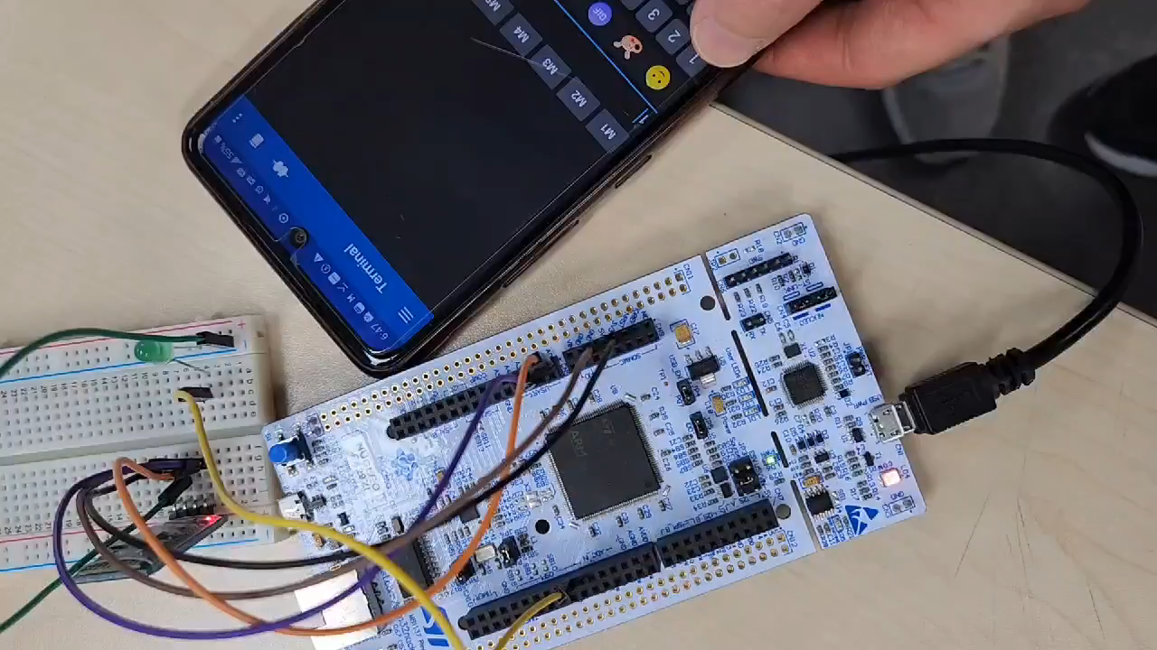
Notes:
1 : LED ON
2 : LED OFF
/* USER CODE BEGIN Header */
/**
******************************************************************************
* @file : main.c
* @brief : Main program body
******************************************************************************
* @attention
*
* Copyright (c) 2023 STMicroelectronics.
* All rights reserved.
*
* This software is licensed under terms that can be found in the LICENSE file
* in the root directory of this software component.
* If no LICENSE file comes with this software, it is provided AS-IS.
*
******************************************************************************
*/
/* USER CODE END Header */
/* Includes ------------------------------------------------------------------*/
#include "main.h"
/* Private includes ----------------------------------------------------------*/
/* USER CODE BEGIN Includes */
/* USER CODE END Includes */
/* Private typedef -----------------------------------------------------------*/
/* USER CODE BEGIN PTD */
/* USER CODE END PTD */
/* Private define ------------------------------------------------------------*/
/* USER CODE BEGIN PD */
/* USER CODE END PD */
/* Private macro -------------------------------------------------------------*/
/* USER CODE BEGIN PM */
/* USER CODE END PM */
/* Private variables ---------------------------------------------------------*/
UART_HandleTypeDef huart1;
UART_HandleTypeDef huart2;
/* USER CODE BEGIN PV */
/* USER CODE END PV */
/* Private function prototypes -----------------------------------------------*/
void SystemClock_Config(void);
static void MX_GPIO_Init(void);
static void MX_USART1_UART_Init(void);
static void MX_USART2_UART_Init(void);
/* USER CODE BEGIN PFP */
/* USER CODE END PFP */
/* Private user code ---------------------------------------------------------*/
/* USER CODE BEGIN 0 */
int _write(int file, char * p, int len){ //
HAL_UART_Transmit(&huart1 , (uint8_t *)p, len, 10);
HAL_UART_Transmit(&huart2 , (uint8_t *)p, len, 10);
return len;
}
/* USER CODE END 0 */
/**
* @brief The application entry point.
* @retval int
*/
int main(void)
{
/* USER CODE BEGIN 1 */
/* USER CODE END 1 */
/* MCU Configuration--------------------------------------------------------*/
/* Reset of all peripherals, Initializes the Flash interface and the Systick. */
HAL_Init();
/* USER CODE BEGIN Init */
/* USER CODE END Init */
/* Configure the system clock */
SystemClock_Config();
/* USER CODE BEGIN SysInit */
/* USER CODE END SysInit */
/* Initialize all configured peripherals */
MX_GPIO_Init();
MX_USART1_UART_Init();
MX_USART2_UART_Init();
/* USER CODE BEGIN 2 */
uint8_t data = 0;
uint8_t num = 0;
/* USER CODE END 2 */
/* Infinite loop */
/* USER CODE BEGIN WHILE */
printf("connected\r\n");
while (1)
{
/* USER CODE END WHILE */
/* USER CODE BEGIN 3 */
HAL_UART_Receive(&huart1, &data, 1, 10);
switch(data)
{
case '0':
HAL_GPIO_TogglePin(GPIOC, GPIO_PIN_0);
if(HAL_GPIO_ReadPin(GPIOC, GPIO_PIN_0))
{
num = num | (1 << 0);
printf("LED0 ON hex : %x\r\n", num);
}
else
{
num = num & ~(1 << 0);
printf("LED0 OFF hex : %x\r\n", num);
}
break;
case '1':
HAL_GPIO_TogglePin(GPIOC, GPIO_PIN_1);
if(HAL_GPIO_ReadPin(GPIOC, GPIO_PIN_1))
{
num = num | (1 << 1);
printf("LED1 ON hex : %x\r\n", num);
}
else
{
num = num & ~(1 << 1);
printf("LED1 OFF hex : %x\r\n", num);
}
break;
case '2':
HAL_GPIO_TogglePin(GPIOC, GPIO_PIN_2);
if(HAL_GPIO_ReadPin(GPIOC, GPIO_PIN_2))
{
num = num | (1 << 2);
printf("LED2 ON hex : %x\r\n", num);
}
else
{
num = num & ~(1 << 2);
printf("LED2 OFF hex : %x\r\n", num);
}
break;
case '3':
HAL_GPIO_TogglePin(GPIOC, GPIO_PIN_3);
if(HAL_GPIO_ReadPin(GPIOC, GPIO_PIN_3))
{
num = num | (1 << 3);
printf("LED3 ON hex : %x\r\n", num);
}
else
{
num = num & ~(1 << 3);
printf("LED3 OFF hex : %x\r\n", num);
}
break;
case '4':
HAL_GPIO_TogglePin(GPIOC, GPIO_PIN_4);
if(HAL_GPIO_ReadPin(GPIOC, GPIO_PIN_4))
{
num = num | (1 << 4);
printf("LED4 ON hex : %x\r\n", num);
}
else
{
num = num & ~(1 << 4);
printf("LED4 OFF hex : %x\r\n", num);
}
break;
case '5':
HAL_GPIO_TogglePin(GPIOC, GPIO_PIN_5);
if(HAL_GPIO_ReadPin(GPIOC, GPIO_PIN_5))
{
num = num | (1 << 5);
printf("LED5 ON hex : %x\r\n", num);
}
else
{
num = num & ~(1 << 5);
printf("LED5 OFF hex : %x\r\n", num);
}
break;
case '6':
HAL_GPIO_TogglePin(GPIOC, GPIO_PIN_6);
if(HAL_GPIO_ReadPin(GPIOC, GPIO_PIN_6))
{
num = num | (1 << 6);
printf("LED6 ON hex : %x\r\n", num);
}
else
{
num = num & ~(1 << 6);
printf("LED6 OFF hex : %x\r\n", num);
}
break;
case '7':
HAL_GPIO_TogglePin(GPIOC, GPIO_PIN_7);
if(HAL_GPIO_ReadPin(GPIOC, GPIO_PIN_7))
{
num = num | (1 << 7);
printf("LED7 ON hex : %x\r\n", num);
}
else
{
num = num & ~(1 << 7);
printf("LED7 OFF hex : %x\r\n", num);
}
break;
}
data = 0;
}
/* USER CODE END 3 */
}
/**
* @brief System Clock Configuration
* @retval None
*/
void SystemClock_Config(void)
{
RCC_OscInitTypeDef RCC_OscInitStruct = {0};
RCC_ClkInitTypeDef RCC_ClkInitStruct = {0};
/** Configure the main internal regulator output voltage
*/
__HAL_RCC_PWR_CLK_ENABLE();
__HAL_PWR_VOLTAGESCALING_CONFIG(PWR_REGULATOR_VOLTAGE_SCALE1);
/** Initializes the RCC Oscillators according to the specified parameters
* in the RCC_OscInitTypeDef structure.
*/
RCC_OscInitStruct.OscillatorType = RCC_OSCILLATORTYPE_HSI;
RCC_OscInitStruct.HSIState = RCC_HSI_ON;
RCC_OscInitStruct.HSICalibrationValue = RCC_HSICALIBRATION_DEFAULT;
RCC_OscInitStruct.PLL.PLLState = RCC_PLL_NONE;
if (HAL_RCC_OscConfig(&RCC_OscInitStruct) != HAL_OK)
{
Error_Handler();
}
/** Initializes the CPU, AHB and APB buses clocks
*/
RCC_ClkInitStruct.ClockType = RCC_CLOCKTYPE_HCLK|RCC_CLOCKTYPE_SYSCLK
|RCC_CLOCKTYPE_PCLK1|RCC_CLOCKTYPE_PCLK2;
RCC_ClkInitStruct.SYSCLKSource = RCC_SYSCLKSOURCE_HSI;
RCC_ClkInitStruct.AHBCLKDivider = RCC_SYSCLK_DIV1;
RCC_ClkInitStruct.APB1CLKDivider = RCC_HCLK_DIV1;
RCC_ClkInitStruct.APB2CLKDivider = RCC_HCLK_DIV1;
if (HAL_RCC_ClockConfig(&RCC_ClkInitStruct, FLASH_LATENCY_0) != HAL_OK)
{
Error_Handler();
}
}
/**
* @brief USART1 Initialization Function
* @param None
* @retval None
*/
static void MX_USART1_UART_Init(void)
{
/* USER CODE BEGIN USART1_Init 0 */
/* USER CODE END USART1_Init 0 */
/* USER CODE BEGIN USART1_Init 1 */
/* USER CODE END USART1_Init 1 */
huart1.Instance = USART1;
huart1.Init.BaudRate = 115200;
huart1.Init.WordLength = UART_WORDLENGTH_8B;
huart1.Init.StopBits = UART_STOPBITS_1;
huart1.Init.Parity = UART_PARITY_NONE;
huart1.Init.Mode = UART_MODE_TX_RX;
huart1.Init.HwFlowCtl = UART_HWCONTROL_NONE;
huart1.Init.OverSampling = UART_OVERSAMPLING_16;
if (HAL_UART_Init(&huart1) != HAL_OK)
{
Error_Handler();
}
/* USER CODE BEGIN USART1_Init 2 */
/* USER CODE END USART1_Init 2 */
}
/**
* @brief USART2 Initialization Function
* @param None
* @retval None
*/
static void MX_USART2_UART_Init(void)
{
/* USER CODE BEGIN USART2_Init 0 */
/* USER CODE END USART2_Init 0 */
/* USER CODE BEGIN USART2_Init 1 */
/* USER CODE END USART2_Init 1 */
huart2.Instance = USART2;
huart2.Init.BaudRate = 115200;
huart2.Init.WordLength = UART_WORDLENGTH_8B;
huart2.Init.StopBits = UART_STOPBITS_1;
huart2.Init.Parity = UART_PARITY_NONE;
huart2.Init.Mode = UART_MODE_TX_RX;
huart2.Init.HwFlowCtl = UART_HWCONTROL_NONE;
huart2.Init.OverSampling = UART_OVERSAMPLING_16;
if (HAL_UART_Init(&huart2) != HAL_OK)
{
Error_Handler();
}
/* USER CODE BEGIN USART2_Init 2 */
/* USER CODE END USART2_Init 2 */
}
/**
* @brief GPIO Initialization Function
* @param None
* @retval None
*/
static void MX_GPIO_Init(void)
{
GPIO_InitTypeDef GPIO_InitStruct = {0};
/* USER CODE BEGIN MX_GPIO_Init_1 */
/* USER CODE END MX_GPIO_Init_1 */
/* GPIO Ports Clock Enable */
__HAL_RCC_GPIOC_CLK_ENABLE();
__HAL_RCC_GPIOA_CLK_ENABLE();
/*Configure GPIO pin Output Level */
HAL_GPIO_WritePin(GPIOC, LED0_Pin|LED1_Pin|LED2_Pin|LED3_Pin
|LED4_Pin|LED5_Pin|LED6_Pin|LED7_Pin, GPIO_PIN_RESET);
/*Configure GPIO pins : LED0_Pin LED1_Pin LED2_Pin LED3_Pin
LED4_Pin LED5_Pin LED6_Pin LED7_Pin */
GPIO_InitStruct.Pin = LED0_Pin|LED1_Pin|LED2_Pin|LED3_Pin
|LED4_Pin|LED5_Pin|LED6_Pin|LED7_Pin;
GPIO_InitStruct.Mode = GPIO_MODE_OUTPUT_PP;
GPIO_InitStruct.Pull = GPIO_NOPULL;
GPIO_InitStruct.Speed = GPIO_SPEED_FREQ_LOW;
HAL_GPIO_Init(GPIOC, &GPIO_InitStruct);
/* USER CODE BEGIN MX_GPIO_Init_2 */
/* USER CODE END MX_GPIO_Init_2 */
}
/* USER CODE BEGIN 4 */
/* USER CODE END 4 */
/**
* @brief This function is executed in case of error occurrence.
* @retval None
*/
void Error_Handler(void)
{
/* USER CODE BEGIN Error_Handler_Debug */
/* User can add his own implementation to report the HAL error return state */
__disable_irq();
while (1)
{
}
/* USER CODE END Error_Handler_Debug */
}
#ifdef USE_FULL_ASSERT
/**
* @brief Reports the name of the source file and the source line number
* where the assert_param error has occurred.
* @param file: pointer to the source file name
* @param line: assert_param error line source number
* @retval None
*/
void assert_failed(uint8_t *file, uint32_t line)
{
/* USER CODE BEGIN 6 */
/* User can add his own implementation to report the file name and line number,
ex: printf("Wrong parameters value: file %s on line %d\r\n", file, line) */
/* USER CODE END 6 */
}
#endif /* USE_FULL_ASSERT */

